Slide 1
Dahua EU Digital COVID Certificate Verification

Slide 2
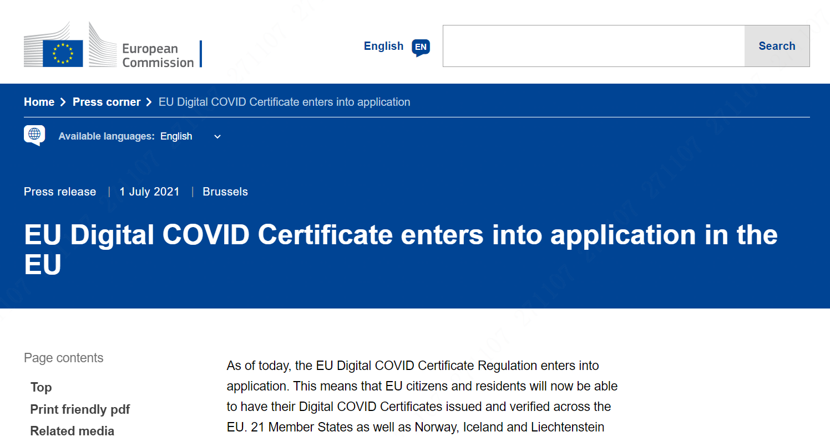
Background
17 March 2021
The Commission proposed a legislative text.
14 April 2021
The Council adopted its mandate to start negotiations with the European Parliament on the proposal.
20 May 2021
The European Parliament and the Council agreed on the EU Digital COVID Certificate.
1 July 2021
EU Digital COVID Certificate enters into application throughout the EU.
EU
Use EU Digital COVID Certificate as a travel voucher for certain occasions.

Slide 3
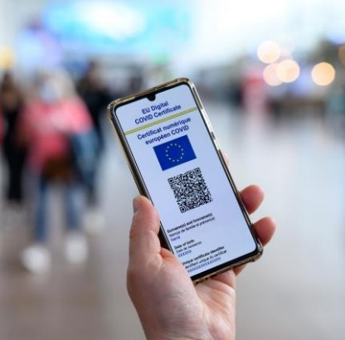
Status Analysis
Face
Recognition
Temperature
Monitoring
Contactless automatic temperature monitoring;
Accurate, fast;
Record abnormal temperature information automatically;
Before
Contactless automatic temperature monitoring;
Accurate, fast;
Record abnormal temperature information automatically;
Verificate EU Digital COVID Certificate of personnel.
New
Now
EU Digital COVID
Certificate Verification
Face
Recognition
Optional
Temperature
Monitoring

Slide 4
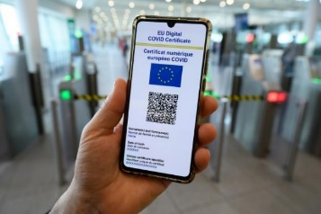
Solution
Monitoring center
Process
①
Standalone
DCC Verification
or
NVR-5X-I
DSS express
+
②
Temperature Measurement

Slide 5
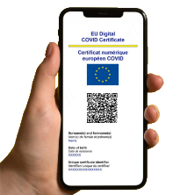
Solution
Entrance guide area
COVID certificate verification area
Venue
COVID Certificate
is abnormal
Entrance
②
+
Temperature or COVID Certificate
is abnormal
①
Entrance

Slide 6
Products
DHI-ASI7213X-V1-T1
+
ASF172X-T1
DHI-ASI7213X
DHI-ASI7213X + ASF172X
DHI-ASI7213X-V1-T1
EU Digital COVID Certificate Verification
/Face Recognition
EU Digital COVID Certificate Verification/Temperature Monitoring/Face Recognition
Unlock Mode: QR code/Card/Remote/Password/Face unlock
Support EU Digital COVID Certificate verification
Face Recognition Time: 0.2s
Working Environment: Indoor and outdoor(IP 65)
Working Temperature: -30°C to +60°C
Unlock Mode: QR code/Card/Remote/Password/Face(under temperature monitoring mode) unlock
Support EU Digital COVID Certificate verification
Temperature Monitoring Error: ≤ 0.5°C
Working Environment: Indoor
Working Temperature: +10°C to +35°C

Slide 7
Thanks!

