Slide 1
Dahua Temperature Monitoring And Face Recognition

Slide 2
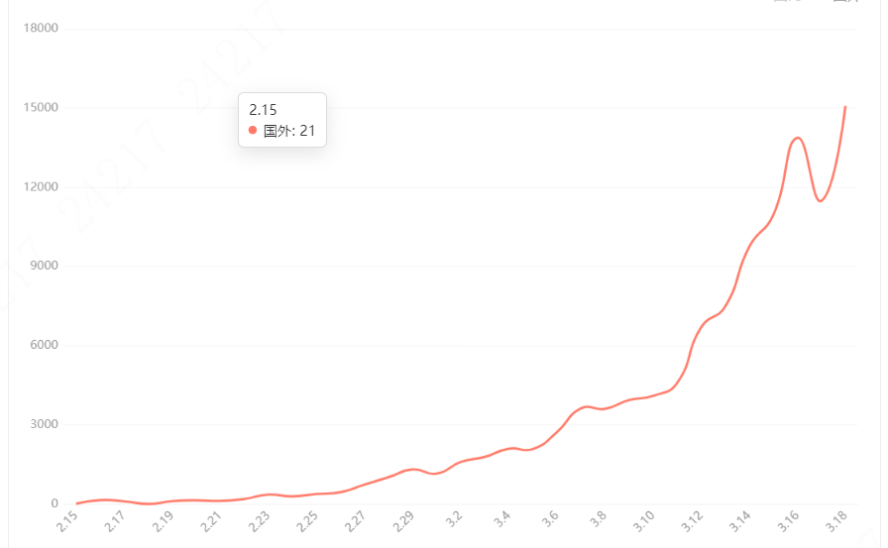
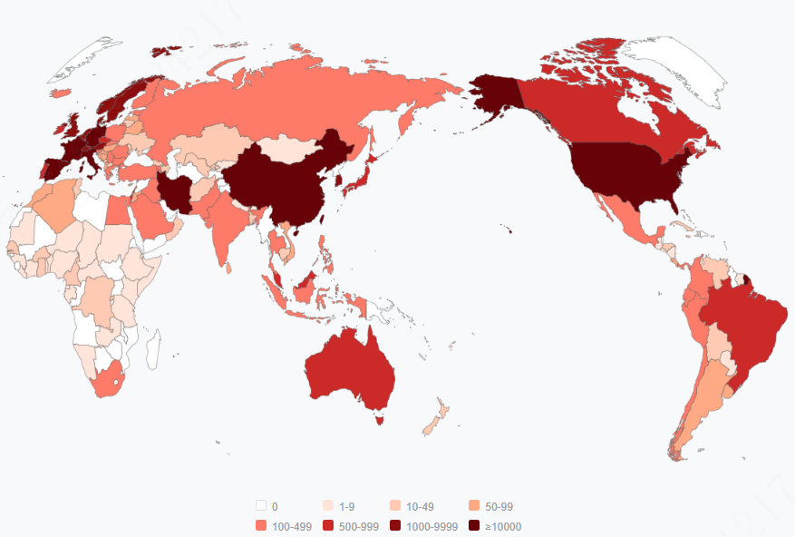
Background
At the end of 2019, Novel Coronavirus (COVID-19) broke out , which is characterized by human-to-human transmission, medical staff infection and community transmission. The disease has spread around the world.

Slide 3
Status Analysis
Body Temperature Monitoring
Key Function
Preliminary Screening
Temperature Record
Low efficiency of thermometer and infrared detection gun
Manual temperature monitoring
workload, high risk
Manual recording is inefficient
Personnel information collection is difficult
Current Status
Non-contact automatic temperature monitoring
Accurate, fast
Record abnormal temperature information automatically
Collect abnormal personnel portrait automatically
Requirement

Slide 4
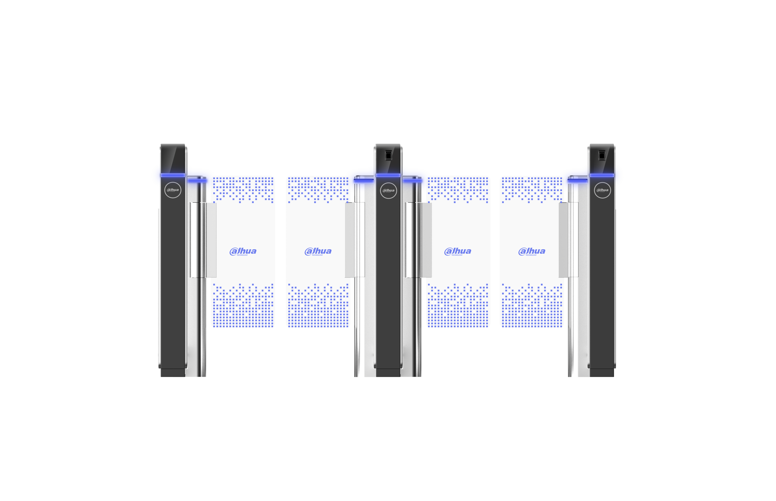
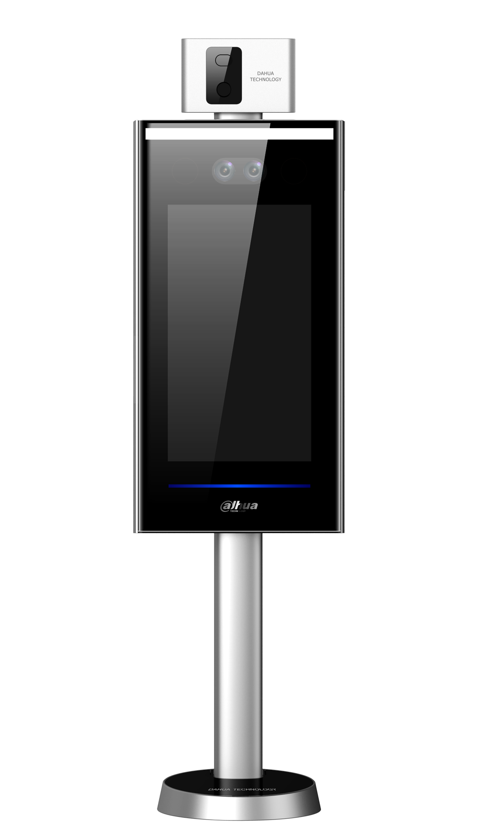
Values
High Accuracy
Turnstile
≤0.5℃
Non - contact
Non - contact temperature detection, quick screening
installation
New project
Renovation project
Installation is simple, on the power is used, convenient to move, can be used standalone without software
Abnormal alarm
Standalone
Support abnormal temperature alarm, non wearing mask alarm
Export report
Support for query and export of abnormal temperature report
variety functions
Wall mounted
Vertical mounted
Support access control, attendance, temperature monitoring, mask detection

Slide 5
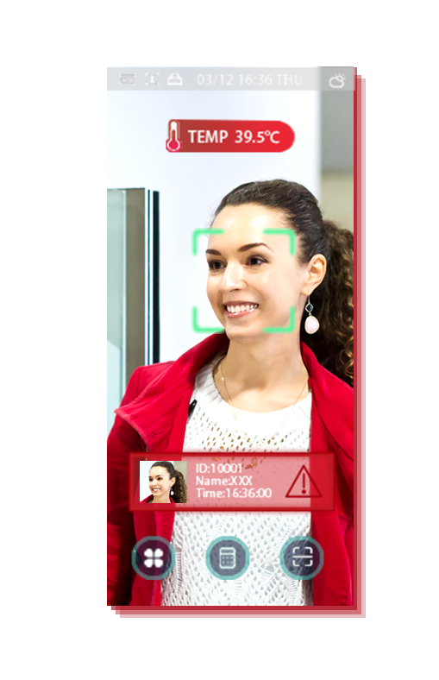
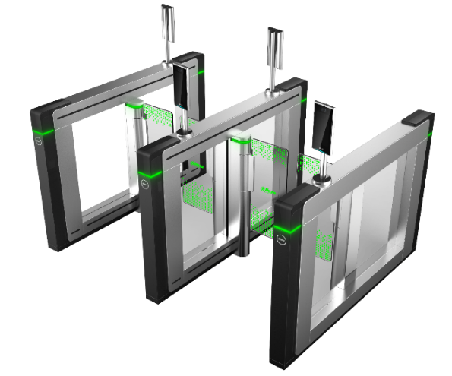
Solution
Entrance guide area
Temperature monitoring area
Isolation area
Temperature is abnormal
Channel
Temperature is abnormal
Channel
Notes:
加黑体，道闸加视场角

Slide 6
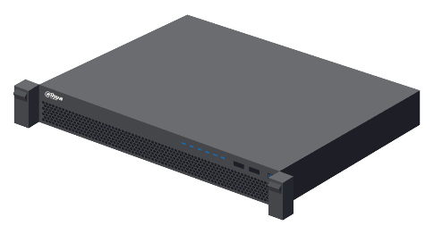
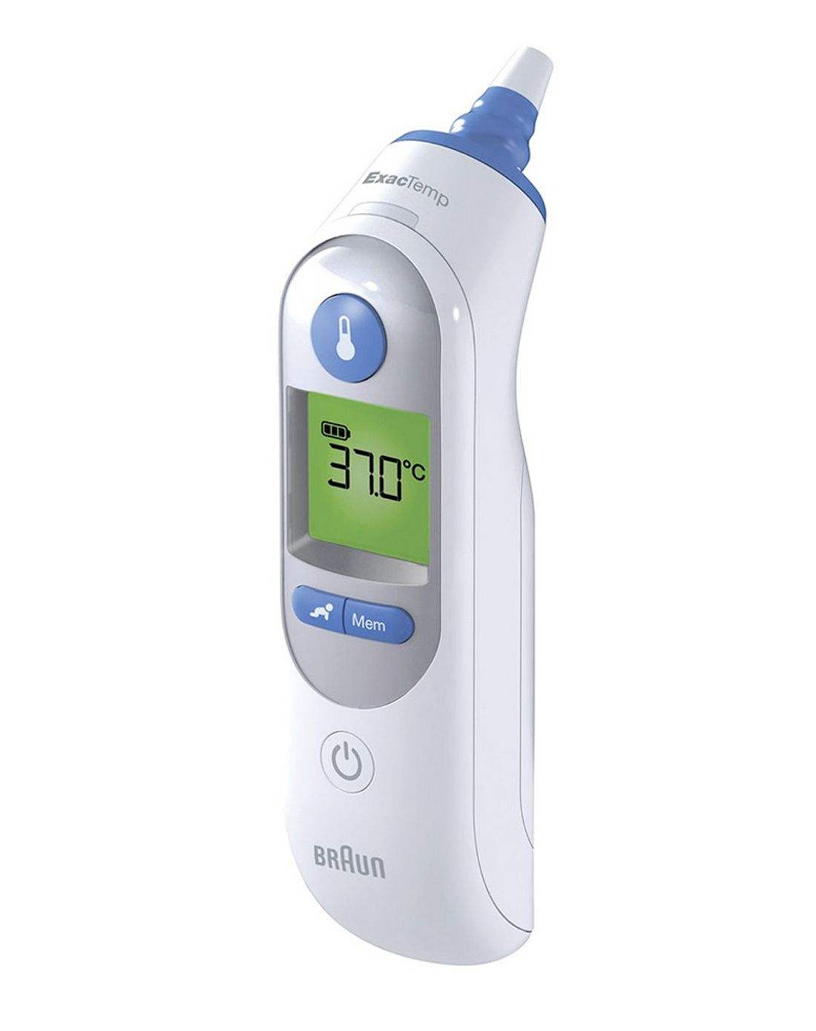
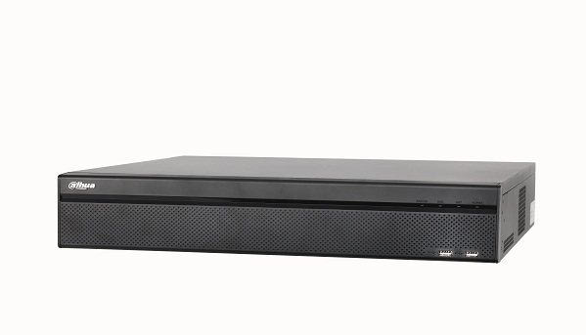
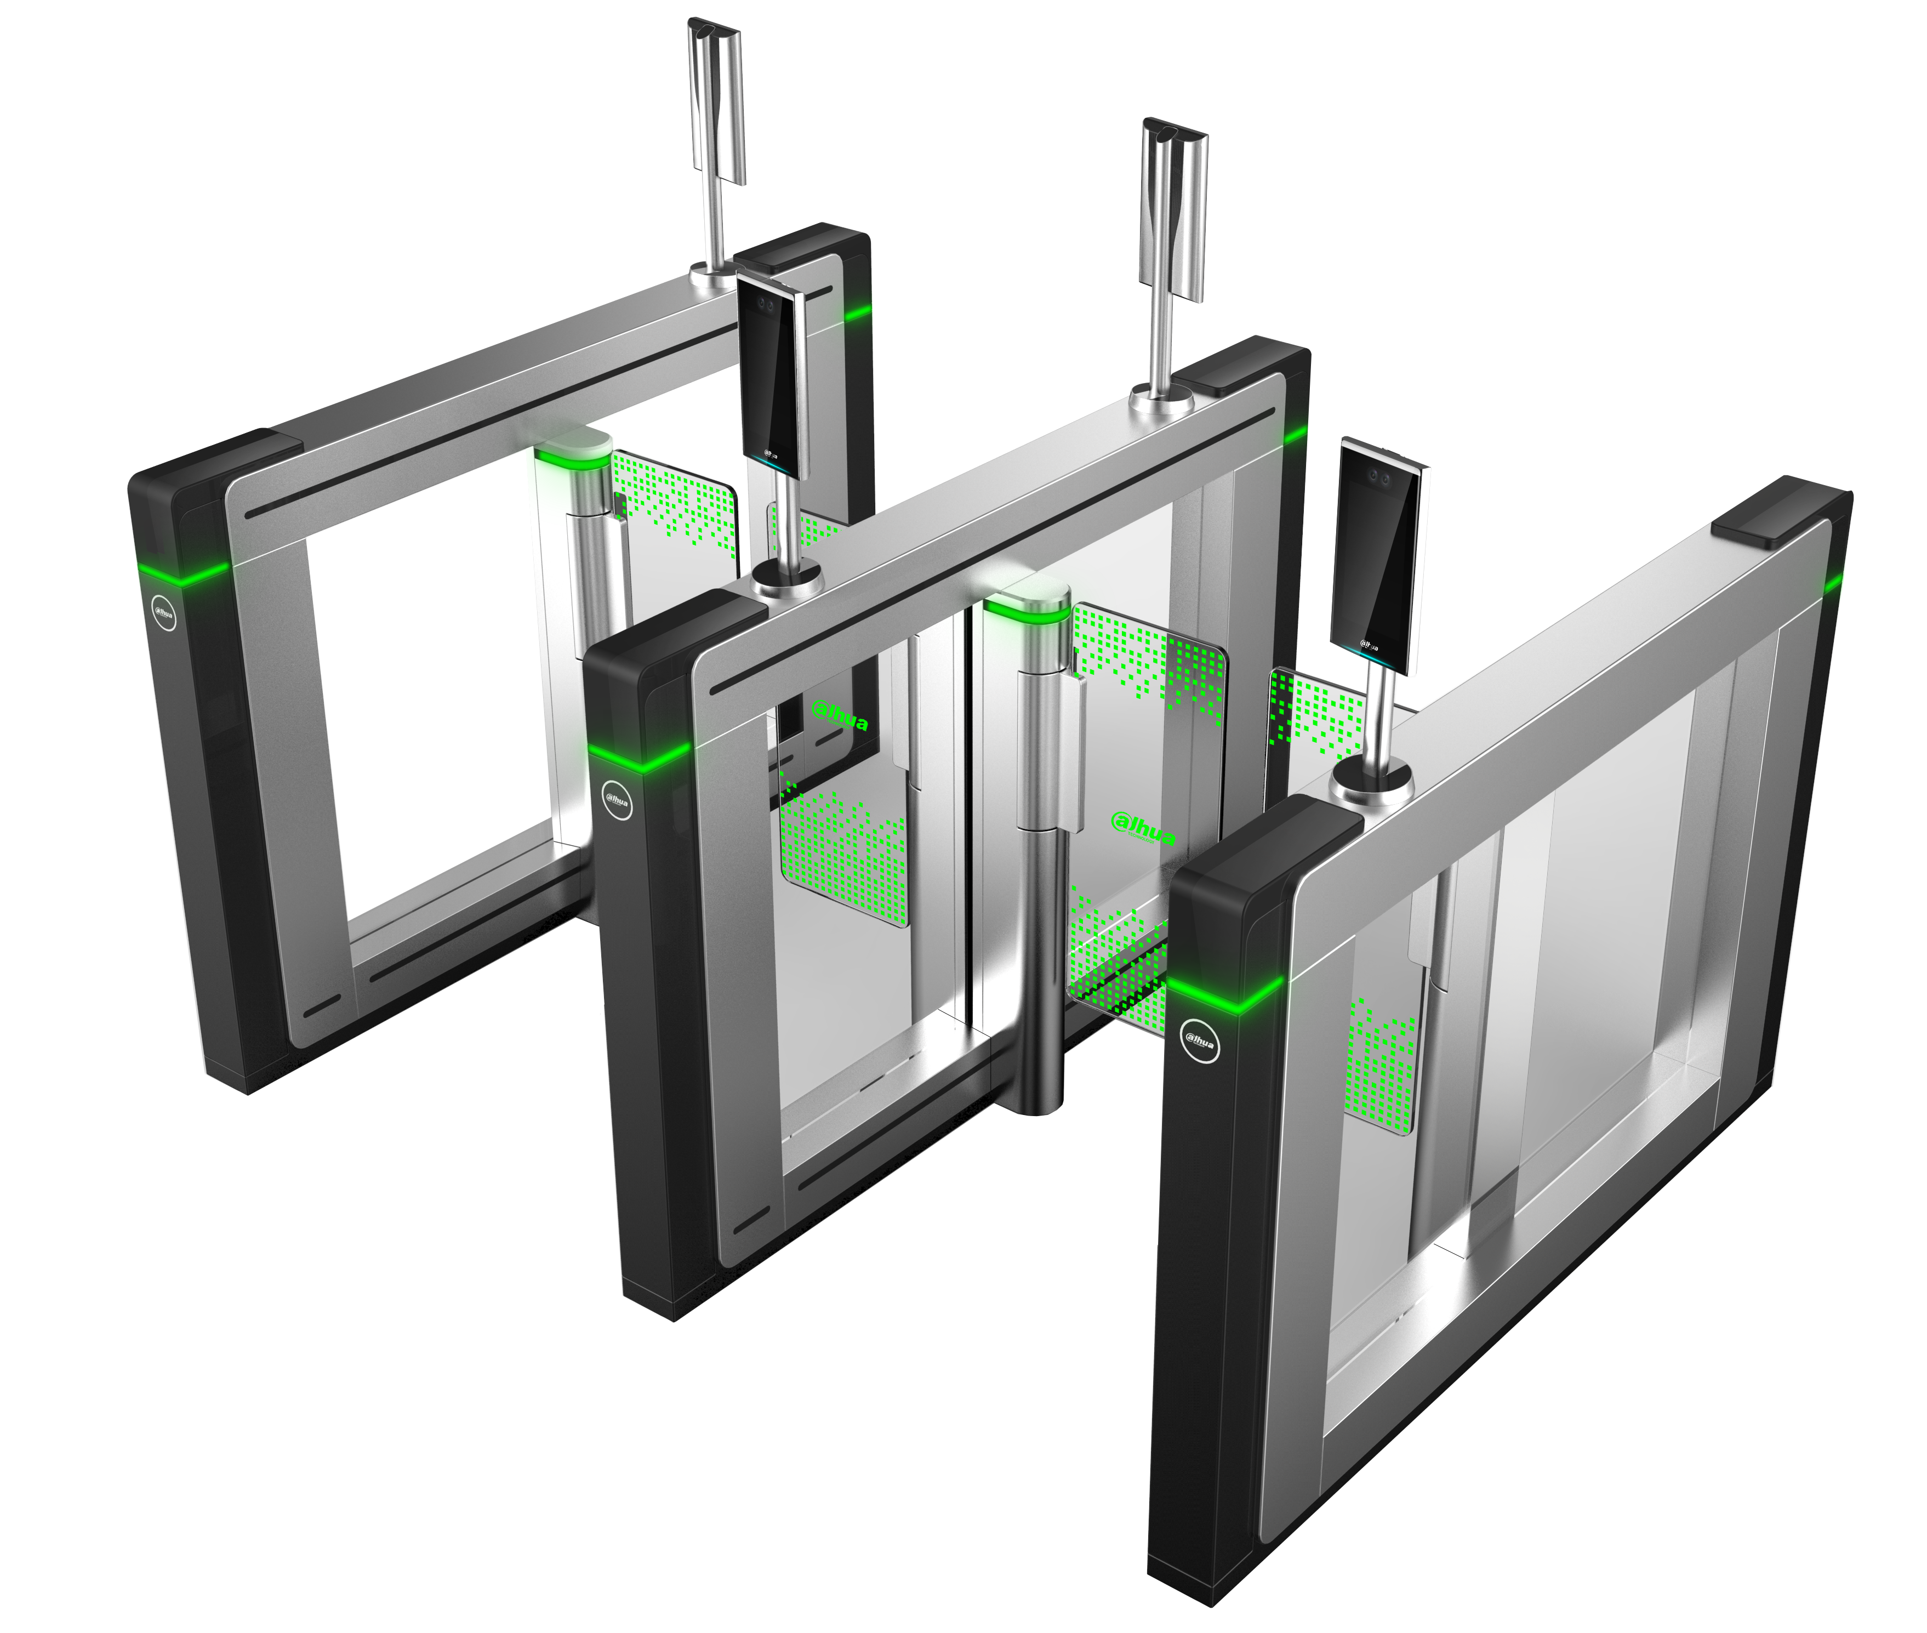
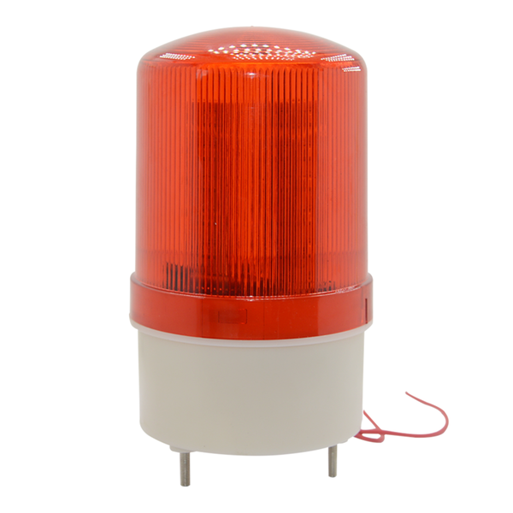
Solution
Process
Monitoring center
Non-contact temperature measurement
Manual review
OR
NVR-5X-I
Dss express
Dss express
Abnormal confirmation
Activate emergency plan
ASI7213X-T1
ASI7213X-T1+ASF172X-T1
DHI-ASGB8xxX
DHI-ASI7223X-A-T1
standalone
turnstiles

Slide 7
Products
Temperature Monitoring and face recognition terminal
DHI-ASI7213X-T1
Temperature Monitoring and face recognition terminal
DHI-ASI7213X-T1 + DHI-ASF172X-T1
Features: temperature monitoring \ no contact
7-inch touch screen
Ambient temperature range ：16°C ~ 32°C
Temperature accuracy: ≤0.5℃
Temperature monitoring distance：0.3m ~ 1.8m
Sound prompt: Temperature abnormal alarm
Unlock Mode: Face/Card/Password
Features: temperature monitoring \ no contact
7-inch touch screen
Ambient temperature range ：16°C~32°C
Temperature accuracy: ≤0.5℃
Temperature monitoring distance：0.3m ~ 1.8m
Sound prompt: Temperature abnormal alarm
Unlock Mode: Face/Card/Password
Notes:
加黑体，道闸加视场角

Slide 8
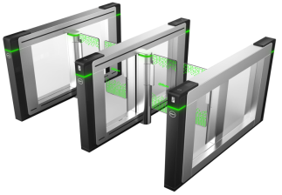
Products
Temperature Monitoring and face recognition terminal
DHI-ASI7223X-A-T1
Turnstiles
DHI-ASGB810X
Features: temperature monitoring \ no contact
7-inch touch screen
Ambient temperature range ：16°C ~ 32°C
Temperature accuracy: ≤0.5℃
Temperature monitoring distance：0.3m ~ 1.8m
Sound prompt: Temperature abnormal alarm
Unlock Mode: Face/Password
Features: security \ rapid transit \ durable
Pedestal material：304 stainless steel, thickness 2.0mm
Motor type：Servo motor
IR Light Detectors: 30 pairs
Lane width ：600mm~1000mm
Barrier material: Acrylic glass
Power: AC 100-240V/50~60HZ
Notes:
加黑体，道闸加视场角

