Slide 1
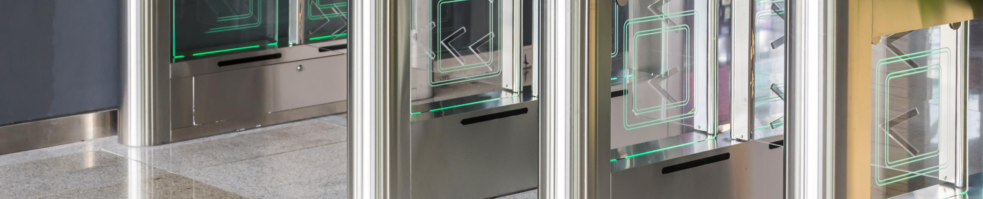
DHI SMB Access Control Temperature Monitoring Solution
Delivery Plan V1.0
Chen Simin / 16018

Slide 2
Objectives
After learning this course, you can:
  Be familiar with the basic theory of the Access Control Temperature Monitoring Solution;
  Get the knowledge of survey and configuration;
  Understand how to debug the system.
  Get the knowledge of the solution FAQ.

Slide 3
01
Overview
02
Survey and Installation
Topology, Scenarios, Device List, Function List
Face Recognition Terminal
03
Configuration
04
FAQ
Upgrade, Face Recognition Terminal, NVR, Express, DMSS
Solution FAQ

Slide 4
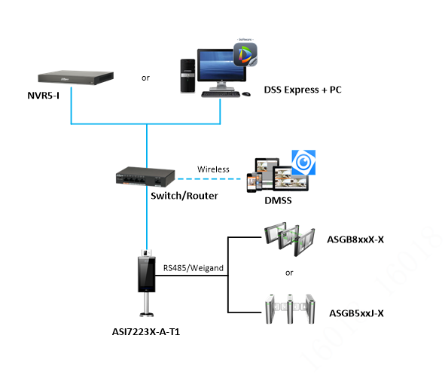
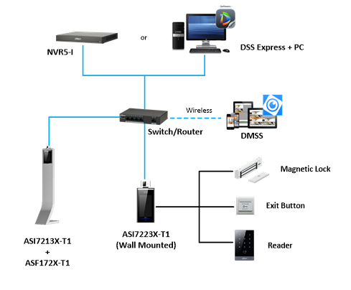
Overview | Topology

Slide 5
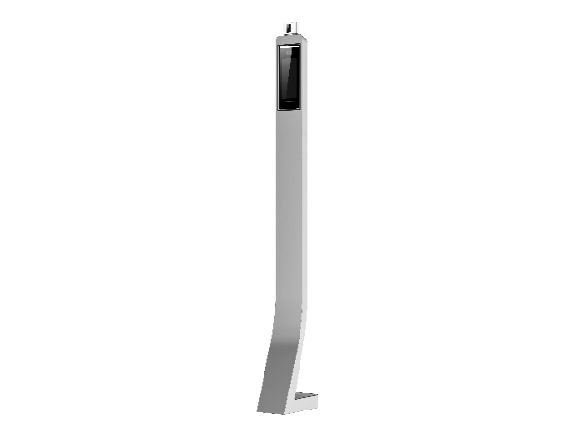
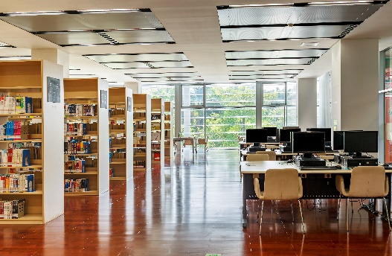
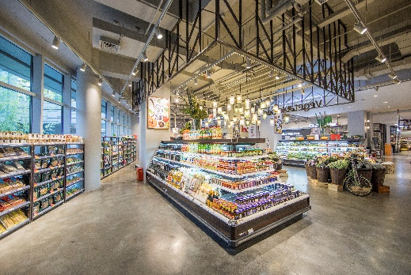
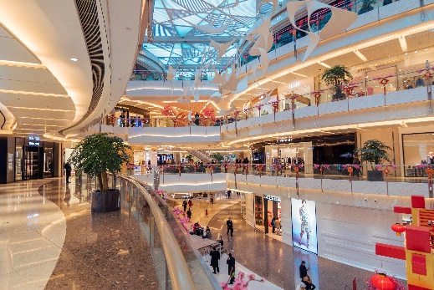


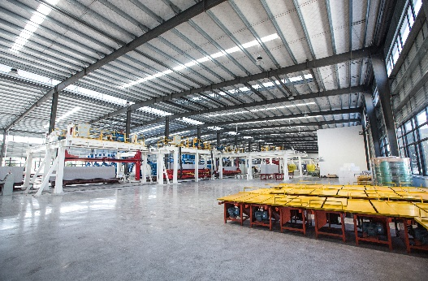
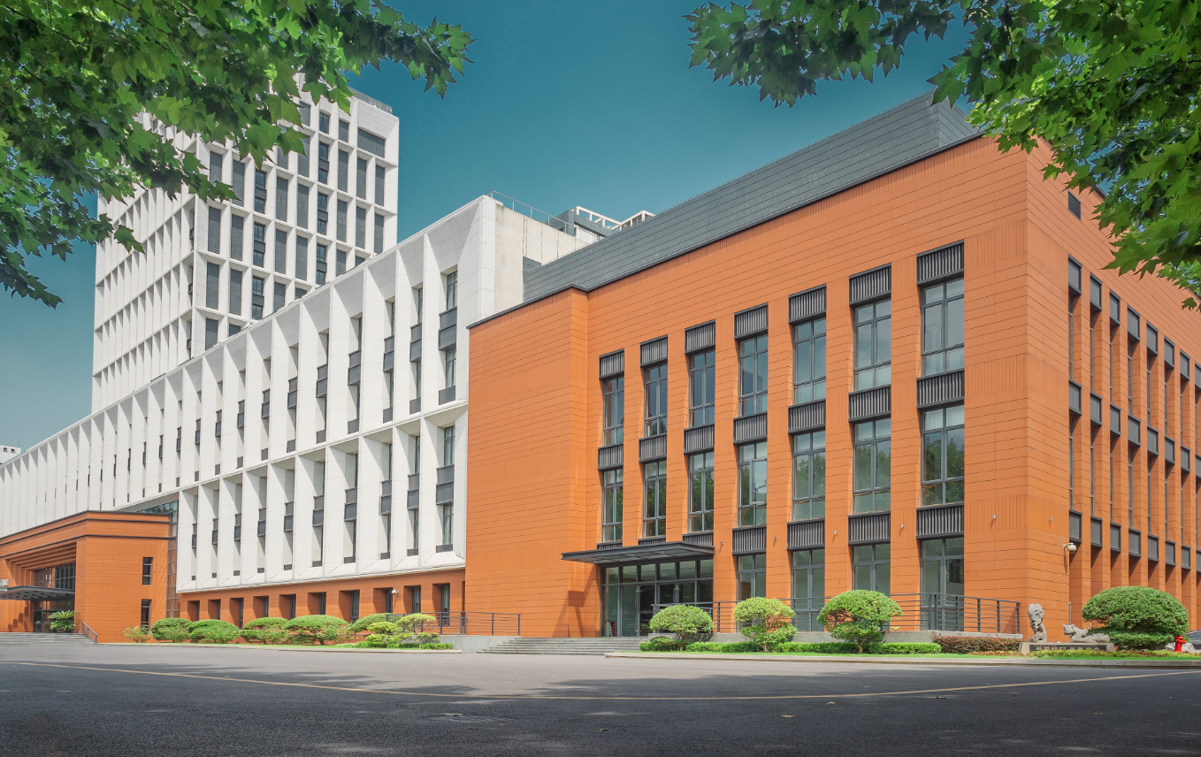
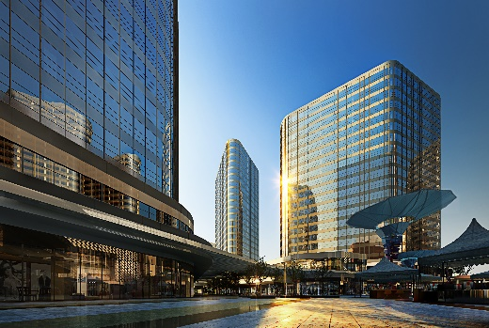
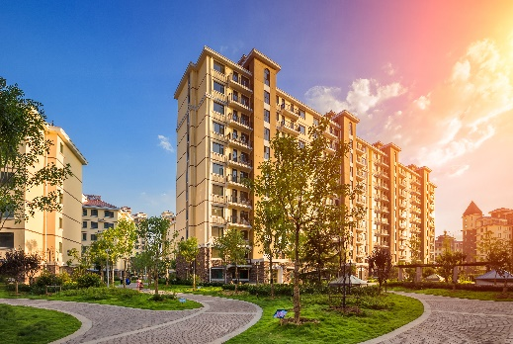
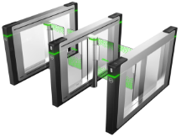
Overview | Application Scenarios
Face Recognition Terminal
Library
Store
Shopping Mall
Chain Restaurant
Face Recognition Terminal
+
Factory
School
Office Building
Residential
Barrier

Slide 6
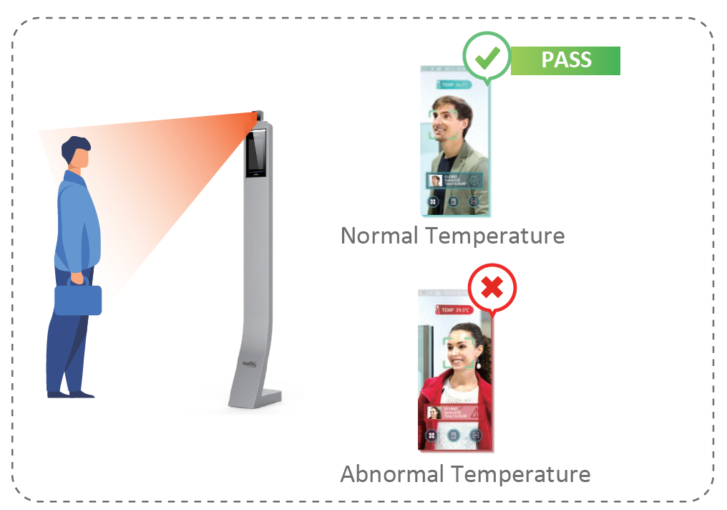
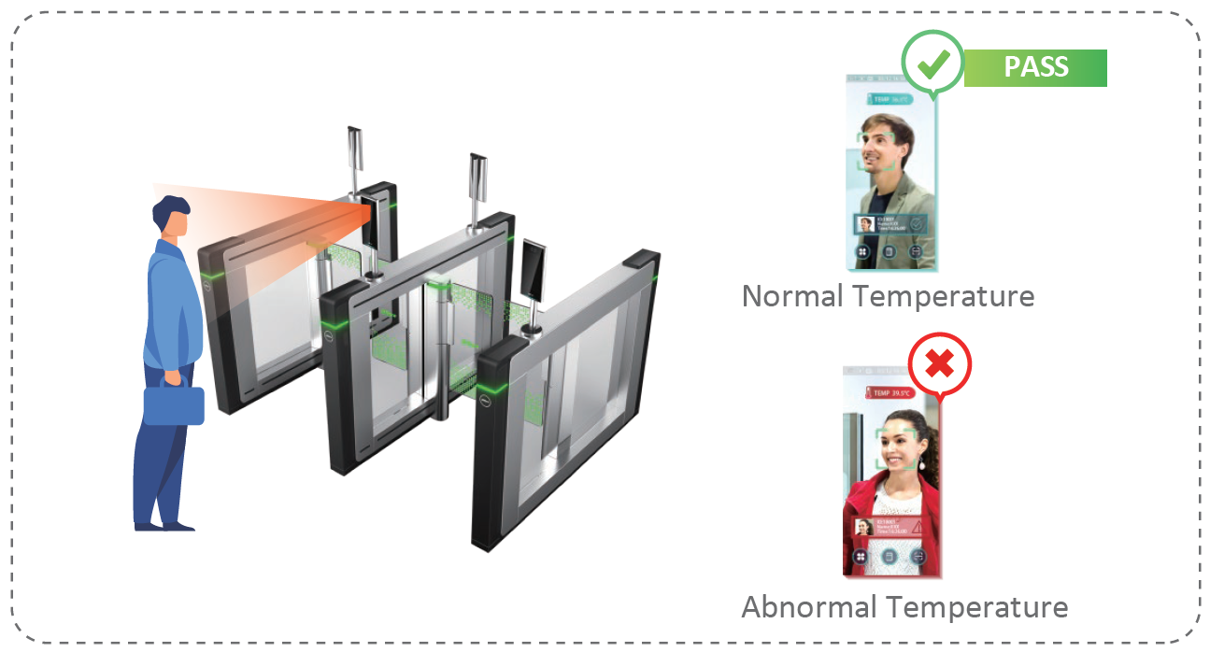
Overview | Solution Process Diagram
Face Recognition/Temperature Monitoring

Slide 7
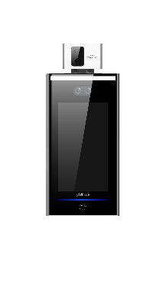

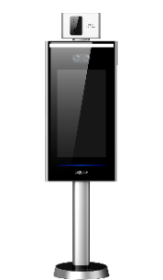
Overview | Device List
NO. | Name | Model | Picture | Technical Specifications
1 | Face Recognition Terminal (Wall mounted) | DHI-ASI7213X-T1/ ASI7213X-T1 |  | 7 Inch LCD display with resolution of 1024×600 Can hold 100,000 users, 100,000 face images, 100,000 cards, 100,000 password, 50 administrators, and 300,000 records Support face, IC card, password unlock and unlock through their combinations With face detection box; the largest face among faces that appear at the same time is recognized first; the maximum face size can be configured on the web Face-camera distance: 0.3 m–2.0 m; human height: 0.9 m–2.4 m(lens-ground distance: 1.4 m)
2 | Standing Bracket For ASI7213X-T1 | ASF172X-T1 |  | Easy installation, Convenient to move Use Galvanized steel Perfect for ASI7213X-T1 device in vertical mounting installation
3 | Face Recognition Terminal for Barrier | DHI-ASI7223X-A-T1 ASI7223X-A-T1 |  | 7 Inch LCD display with resolution of 1024×600 Can hold 100,000 users, 100,000 face images, 100, 000 password, 50 administrators, and 300,000 records Face-camera distance: 0.3 m–2.0 m; human height: 0.9 m–2.4 m (lens-ground distance: 1.4 m) With face recognition algorithm, the terminal can recognize more than 360 positions on human face Face recognition speed: 0.2 s per face

Slide 8

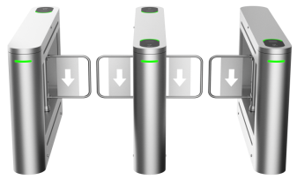

Overview | Device List
NO. | Name | Model | Picture | Technical Specifications
4 | Turnstile 8 series X type |  |  | Brushless servo motor ensures fast and stable operation of the swing turnstile Use SUS304 stainless steel totally, 1.5mm thikness; Two-way or one-way card verification; Smooth and quiet operation; Protect trespassing people not to be injured; Detection 30 pairs of IR detectors Passing Frequency 20 people/minute–40 people/minute Arm length: 600mm；
5 | Turnstile 5 series J type |  |  | 16 Channel IP video access Smart H.265+/H.265/Smart H.264+/H.264/MJPEG Up to 16 Channel perimeter protection Up to 4 Channel video stream face recognition Up to 24 face pictures /sec processing Up to 20 face databases with 100,000 face images in total 1-8 PoE Ports support ePoE & EoC
6 | NVR | DHI-NVR5216-16P-I |  | 16 Channel IP video access Smart H.265+/H.265/Smart H.264+/H.264/MJPEG Up to 16 Channel perimeter protection Up to 4 Channel video stream face recognition Up to 24 face pictures /sec processing Up to 20 face databases with 100,000 face images in total 1-8 PoE Ports support ePoE & EoC

Slide 9
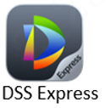

Overview | Device List
NO. | Name | Model | Picture | Technical Specifications
7 | Software | DHI-DSS Express-Base-License |  | Human body high temperature alarm access; Alarm event popup prompt Backup automatically and restore manually in case data lose in abnormal situation Locks the record to keep evidence in case that it could be rewritten
8 | Server | DELL sever R230 Win10 IOT system
9 | App | DMSS |  | Multiple-channel live view (up to 16 windows), and maximum 4-channel playback. Play back videos by fast, slow, or frame mode. Snapshot and video recording. Corresponding files are stored locally. PTZ control by gestures. Automatically play the last-time played video on live interface. Video image and bit stream adjustment. Support voice call. Alarm message subscription and push.

Slide 10
Overview | Function List
NO. | Module | Function | Function Description
1 | Express | Live View and Playback | Add and delete face recognition terminal on Express. View live video with temperature degree overlaid at the upper-right corner.
 |  |  | Search for and play recorded video and pictures on Express.
 |  | Face Management | Configure face database on Express and send the face database to face recognition controller. Support up to two face images per person, one wearing mouth mask and the other for full face.
 |  | Access Control Records | Search for and export access control records with abnormal temperatures and mask detection info. The reports can be exported by day and week.
 |  | Temperature and Mask Event Record | Express displays abnormal temperatures and no mask cases in the access control records.
 |  |  | In the face + card mode, the access control records are uploaded to Express with temperature info. People info can be viewed through searching for abnormal temperature records ( with one face picture and one face cutout).
 |  |  | In the face + card mode, the access control records with mask detection result are uploaded to Express. People info can be viewed through searching for mask-wearing detection records ( with one face picture and one face cutout).
 |  |  | Express can display the temperature info and related face images on the AI panel in real time.
 |  | Alarm | Support linked actions to temperature and mask alarms, such as linked email and pop-up window. When there are both the temperature alarm and mask alarm from one person, the temperature alarm has the priority.

Slide 11
Overview | Function List
NO. | Module | Function | Function Description
2 | NVR | Live View and Playback | Add and delete face recognition terminal on NVR. View live video with temperature degree overlaid at the upper-right corner.
 |  |  | Search for and play recorded video and pictures on NVR.
 |  | Temperature and Mask Event Record | NVR can display the temperature info and related face images on the AI panel in real time. The panel displays face pictures, face cutouts, with mask or not, temperature info, daily statistics and videos. The Navigation Bar shows person ID and name.
 |  |  | Add tags to abnormal events. For a person with fever and no mask, the event is reported as a temperature event.
 |  |  | NVR displays the number of detected people, abnormal temperatures, and mask detections, which can be searched by name, date and time, and exported into Excel.
 |  | Alarm | Support linked actions to temperature and mask alarms, such as linked email, alarm output, and buzzer. When there are both the temperature alarm and mask alarm from one person, the temperature alarm has the priority.
3 | DMSS | Live View and Playback | Add and delete face recognition terminal by P2P protocol on DMSS. View live video. The main stream video shows temperature info.
 |  | Alarm | Receive alarms from face recognition terminals, and display alarm notifications that contains temperature info and face snapshot.

Slide 12
01
Overview
02
Installation Guidance
Topology, Scenarios, Device List, Function List
Face Recognition Terminal
03
Configuration
04
FAQ
Upgrade, Face Recognition Terminal, NVR, Express, DMSS
Solution FAQ

Slide 13
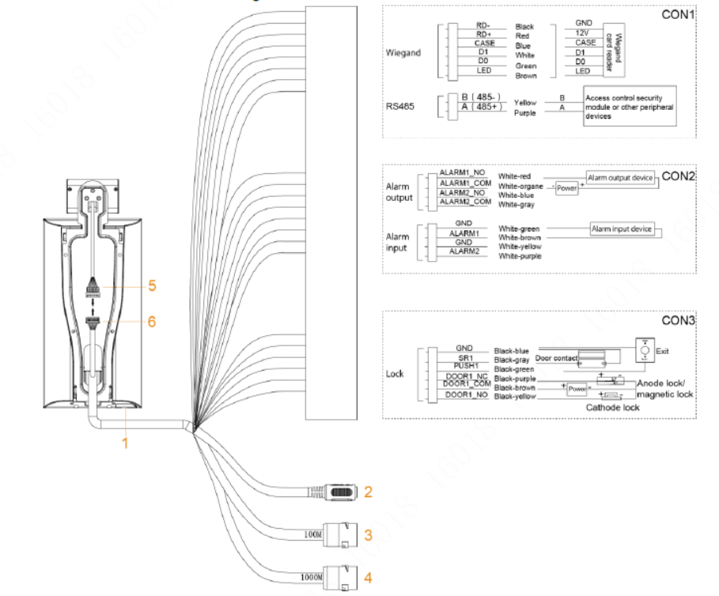
Installation Guidance | Cable Connection
Cable Connection
Installation Notes
Installation Scenarios
Temperature Monitoring Requirement
Notes：This delivery Plan only introduce how to install the Face Recognition Terminal on the wall. About the barrier installation and vertical installation, please refer to the other files.

Slide 14
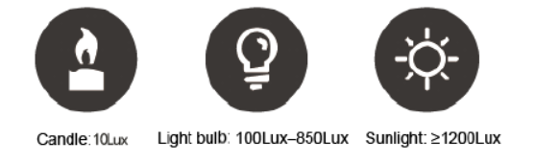
Installation Guidance | Installation Notes
Cable Connection
If there is light source 0.5 meters away from the access controller, the minimum illumination should be no less than 100 Lux.
It is recommended that the access controller is installed indoors, at least 3 meters away from windows and doors and 2 meters away from lights.
Avoid backlight and direct sunlight.
Installation Notes
Installation Scenarios
Temperature Monitoring Requirement
Ambient Illumination Requirement

Slide 15
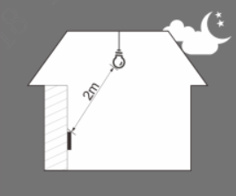
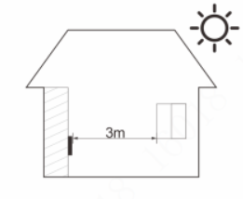
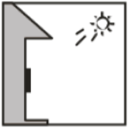
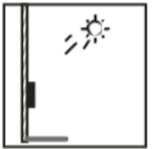
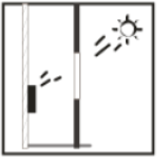
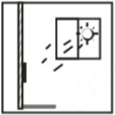
Installation Guidance | Installation Scenarios
Cable Connection
Place Recommended
Installation Notes
Installation Scenarios
Temperature Monitoring Requirement
2 meters away from lights
3 meters away from windows
Place Not Recommended
Backlight
Direct Light
Sunlight goes through the window

Slide 16
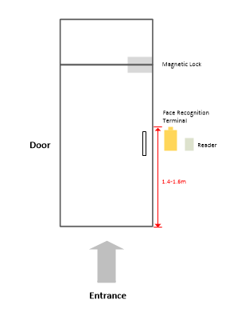
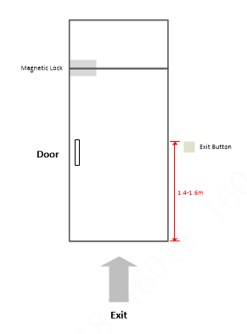
Installation Guidance | Installation Scenarios
Cable Connection
Recommended Installation Scenario：
Installation Notes
Installation Scenarios
Temperature Monitoring Requirement
ASI7213X-T1 support 1 Lock Control, 1 Exit Button

Slide 17
Installation Guidance | Temperature Monitoring Requirement
Cable Connection
It is recommended to install the temperature monitoring unit in an indoor windless environment (a relatively isolated area from the outdoor), and maintain the ambient temperature at 15°C to 32°C.
Warm up the temperature monitoring unit for more than 20 minutes after power-on to enable the temperature monitoring unit to reach thermal equilibrium.
If there is no suitable indoor environment (including areas directly facing indoor and outdoor areas, and outdoor doorways), set up a temporary passage with stable ambient temperature for temperature monitoring.
The factors such as sunlight, wind, cold air, and air conditioning cold and warm air can easily affect the surface temperature of human body and the working status of the access controller, which will cause the temperature deviation between the monitored temperature and the actual temperature.
Influencing factors of temperature monitoring
Wind: Wind will take away the heat from the forehead, which  will affect the accuracy of temperature monitoring.
Sweating: Sweating is a way for the body to automatically cool down and dissipate heat. When the body sweats, the temperature will also decrease.
Room temperature: If the room temperature is low, the surface temperature of human body will decrease. If the room temperature is too high, the human body will start to sweat, which will affect the accuracy of temperature monitoring.
The temperature monitoring unit is sensitive to light waves with a wavelength of 10um to 15um. Avoid using it in the sun, fluorescent light sources, air conditioning outlets, heating, cold air outlets, and glass surfaces.
Installation Notes
Installation Scenarios
Temperature Monitoring Requirement

Slide 18
01
Overview
02
Installation Guidance
Topology, Scenarios, Device List, Function List
Face Recognition Terminal
03
Configuration
04
FAQ
Upgrade, Face Recognition Terminal, NVR, Express, DMSS
Solution FAQ

Slide 19
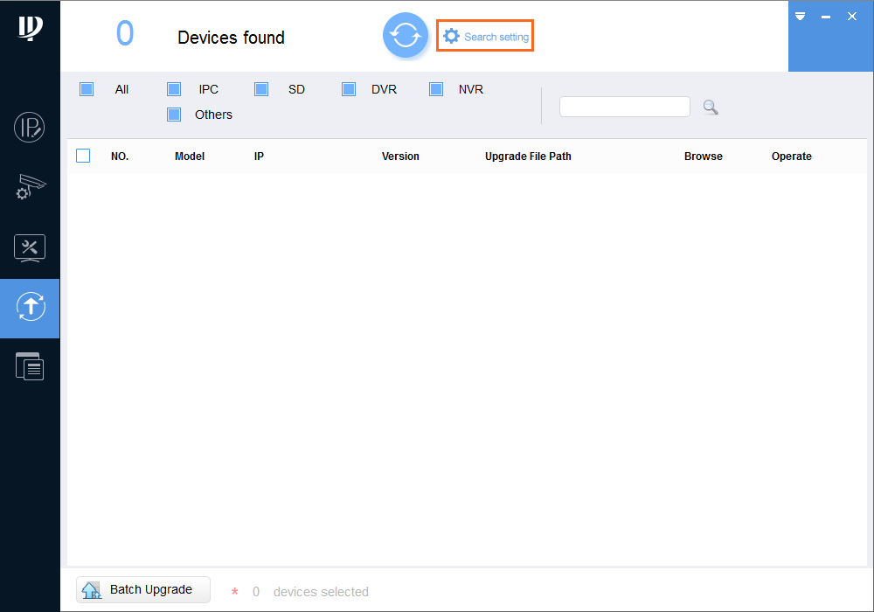

Configuration | Upgrade
Upgrade
Upgrade
3
Configuring Face Recognition Terminal
Configuring NVR
2
Configuring Express
Configuring DMSS
TPC、NVR need to upgrade the customized program.
Double-click "ConfigTool.exe" to open the tool;
Click
Click Search setting.

Slide 20
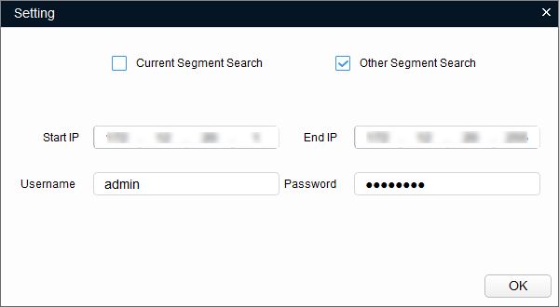
Configuration | Upgrade
Upgrade
Upgrade
Configuring Face Recognition Terminal
4
Configuring NVR
Configuring Express
Configuring DMSS
5
Select the network segment for the target device. If the IP address of the target device is in the current network segment, select Current Segment Search, and then enter the user name and the password of the target camera.
Click OK

Slide 21
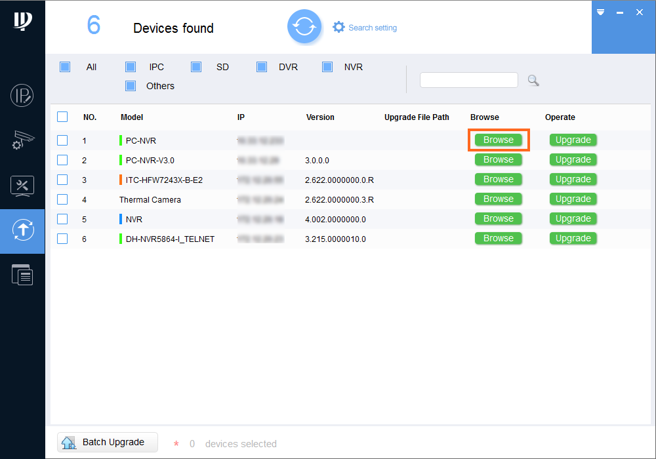
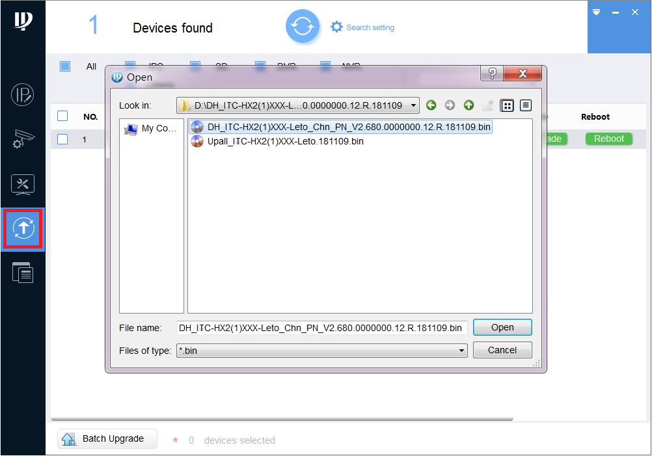
Configuration | Upgrade
Upgrade
Upgrade
Configuring Face Recognition Terminal
Configuring NVR
7
Configuring Express
8
Configuring DMSS
6. Select the devices to update.
Update devices one by one: Select the corresponding device, and then click Browse.
Update devices in batches: Select multiple devices, and then click Batch Upgrade.
Select the update file.
Click Open.
Update the Devices, Update the devices one by one: Click Upgrade, and the system starts updating. You can see the update progress.

Slide 22



Configuration | Configuring Face Recognition Terminal
Upgrade
Configuring Unlock Mode
Creating Face Database
Configuring Face Recognition Parameters
Configuring Face Recognition Terminal
Commissioning
2
Configuring NVR
3
Configuring Express
Configuring DMSS
On the local interface, tap > , then enter the password to log in;
Select Access > Unlock Mode > Unlock Mode;
Tap the mode you need. If you want to support the temperature monitoring function, you have to choose Face. For example, Face, Face and Card, Face and Password.
Tap to save the setting.
PS. If you use Express in your solution, you can configure this function on express.

Slide 23
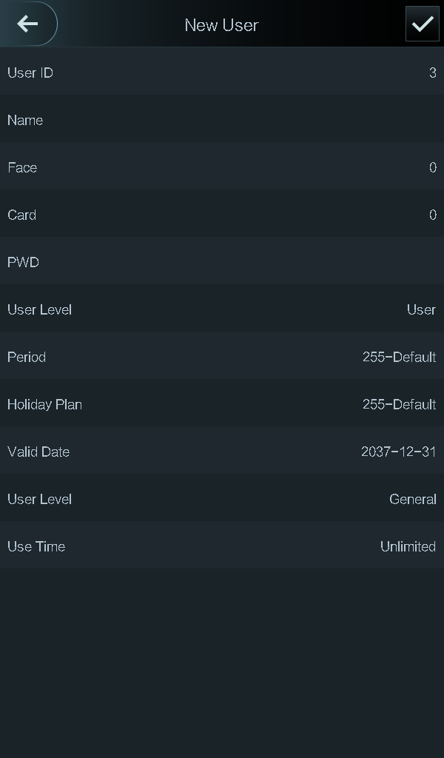
Configuration | Configuring Face Recognition Terminal
Upgrade
Configuring Unlock Mode
Creating Face Database
Configuring Face Recognition Parameters
Configuring Face Recognition Terminal
Commissioning
2
On the local interface, tap > , then enter the password to log in ;
Tap User > New User, and then set user ID, name and level.
Tap Face, and then take a face picture.
If you choose the Face and Card mode, tap Card, then swipe the card, then it will show the card number.
If you choose the Face and Password mode, tap Password, then input the password.
Click to save the setting.
Ps. If you want the batch import function, please use Express.
Configuring NVR
3
Configuring Express
4
5
Configuring DMSS

Slide 24
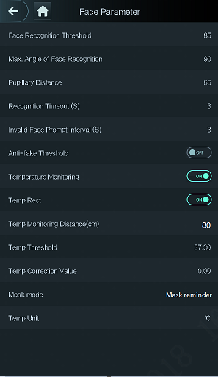
Configuration | Configuring Face Recognition Terminal
Upgrade
Configuring Unlock Mode
Creating Face Database
Configuring Face Recognition Parameters
Configuring Face Recognition Terminal
Commissioning
Configuring NVR
On the local interface, tap > , then enter the password to log in
Tap System > Face Parameter
For these parameters, suggest to keep the default setting
Disable “Anti-Fake Threshold”
Enable “Temperature Monitoring” and “Temp. Rect”
The value is 0 by default. Set other values to enable temperature monitoring within a defined distance. 80 cm is recommended
Choose the Mask Mode as “Mask reminder” or “Mask intercept”.
3
Configuring Express
4
Configuring DMSS
5
6
7

Slide 25
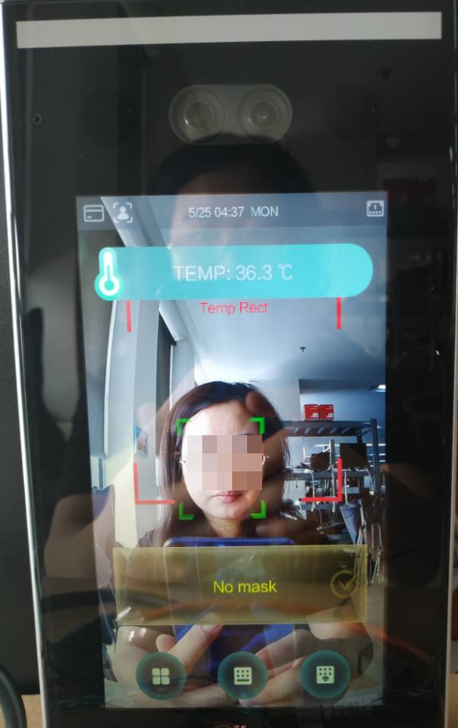
Configuration | Configuring Face Recognition Terminal
Upgrade
Configuring Unlock Mode
Creating Face Database
Configuring Face Recognition Parameters
Configuring Face Recognition Terminal
Commissioning
Configuring NVR
Configuring Express
Configuring DMSS
Stand in front of the face recognition terminal, and check whether the screen shows face recognition result and temperature value, and whether it warns of mask absence.
PS. If you choose Face and Card mode, you have to swipe the card first, then scan your face.

Slide 26
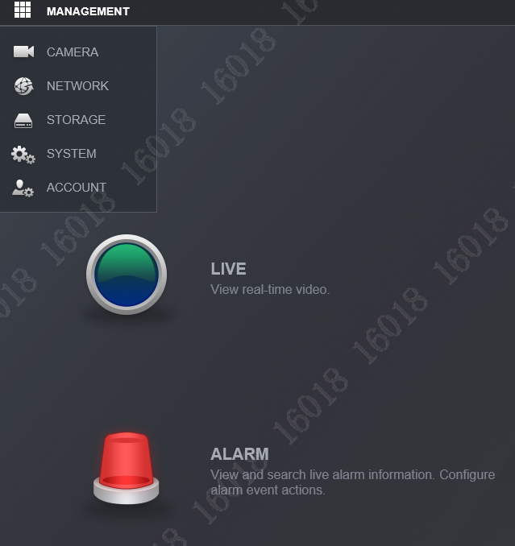
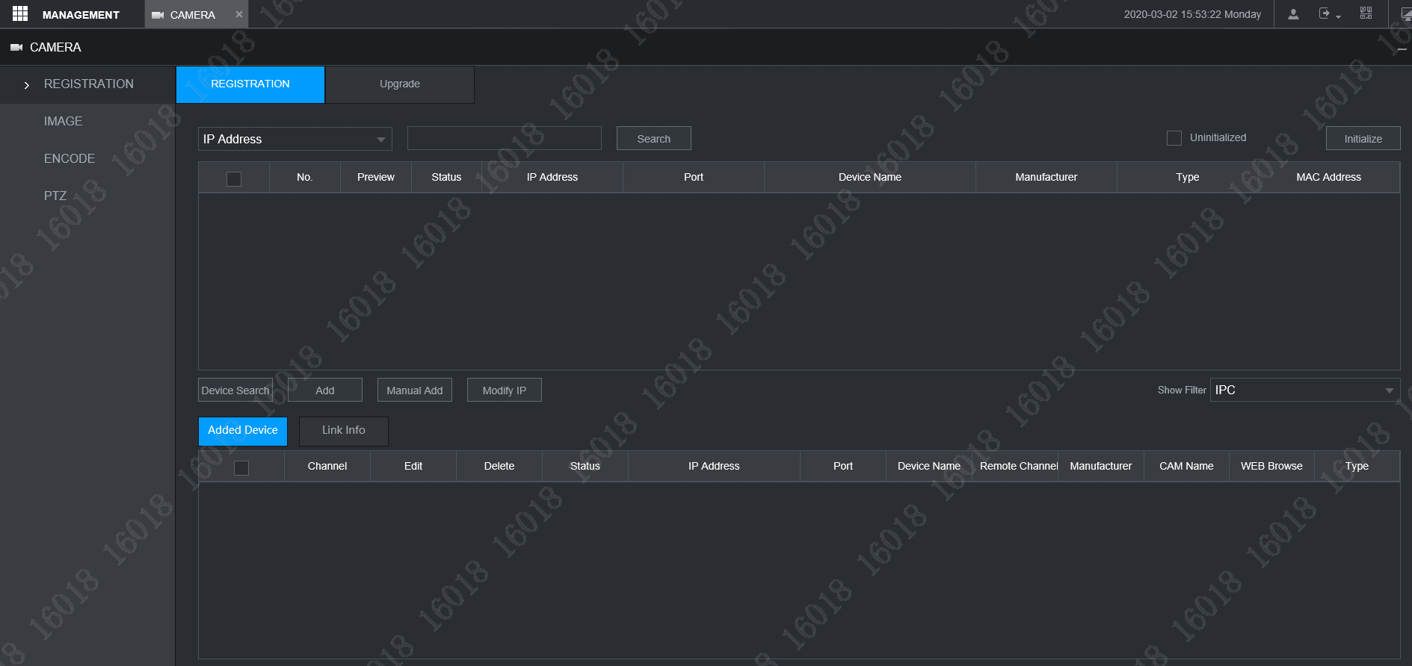
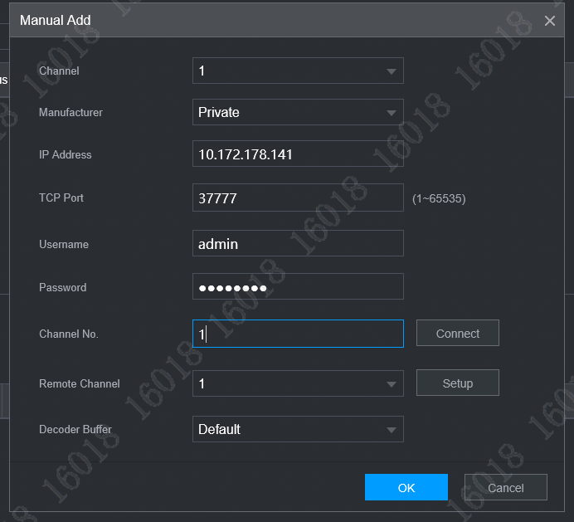
Configuration | Configuring NVR
Upgrade
Adding Devices
Enabling Temperature and Mask Monitoring
Enabling Fahrenheit
Commissioning
Configuring Face Recognition Terminal
1
1
Configuring NVR
3
Configuring Express
2
Configuring DMSS
4
Log in NVR WEB, select [Management] > [Camera] > [Registration] > [Registration]
Select “Manual Add”
Input TPC camera IP, username and password
Click OK

Slide 27
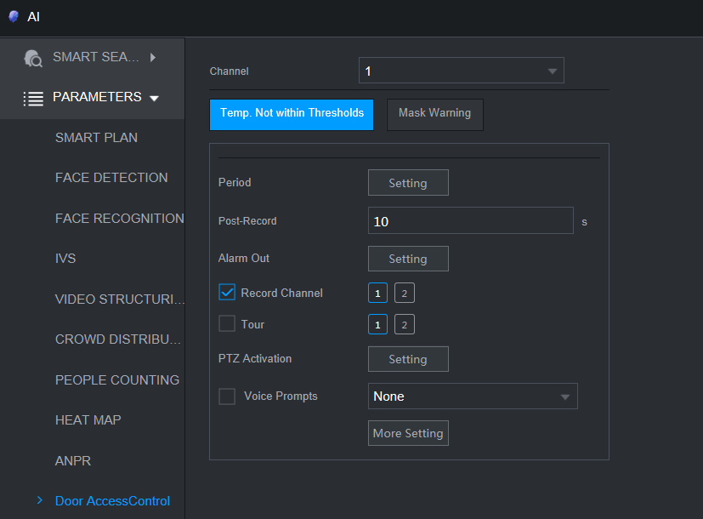
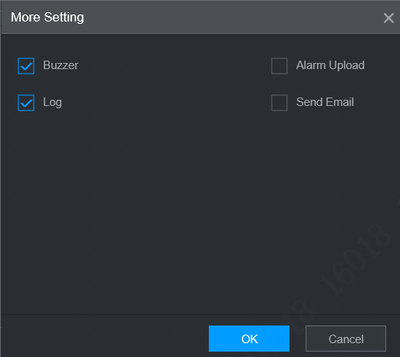
Configuration | Configuring NVR
Upgrade
Adding Devices
Enabling Temperature and Mask Monitoring
Enabling Fahrenheit
Commissioning
Configuring Face Recognition Terminal
2
4
Configuring NVR
3
Configuring Express
Configuring DMSS
1
4
5
Log in to NVR, and then select AI > Parameters > Door Access Control
Select the camera channel from the Channel drop-down list
Click Temp.Not within Thresholds or Mask Warning
Click “More Setting”, you can select the alarm-linked actions
Click OK

Slide 28
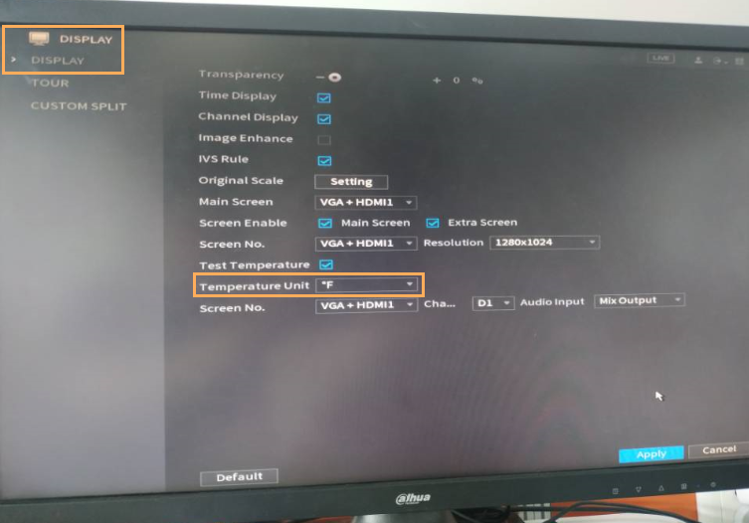
Configuration | Configuring NVR
Upgrade
Adding Devices
Enabling Temperature and Mask Monitoring
Enabling Fahrenheit
Commissioning
Configuring Face Recognition Terminal
Configuring NVR
Configuring Express
Configuring DMSS
If you use Fahrenheit, you need to enable Fahrenheit both on the face recognition terminal and the NVR.
Log in to the local interface of NVR
On the Display interface, select °F from the drop-down list of Temperature Unit
Click Apply

Slide 29
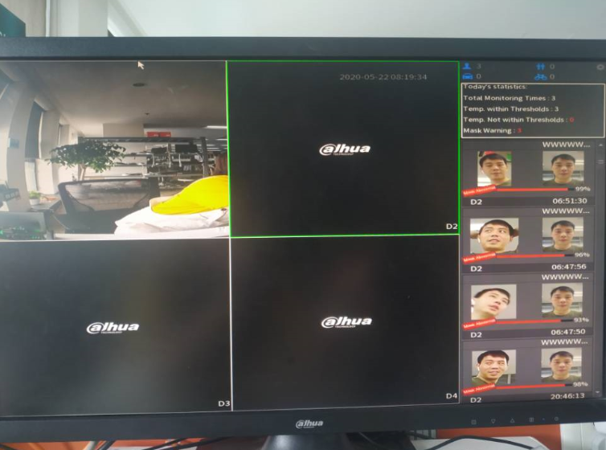
Configuration | Configuring NVR
Upgrade
Adding Devices
Enabling Temperature and Mask Monitoring
Enabling Fahrenheit
Commissioning
Configuring Face Recognition Terminal
Configuring NVR
Configuring Express
Configuring DMSS
On the local interface of NVR, go to the Live interface, and select the face recognition terminal channel. Stand in front of the terminal, and then check whether the NVR shows body temperature and mouth mask monitoring results.

Slide 30
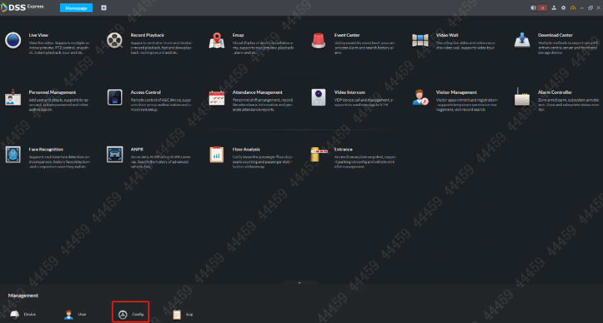
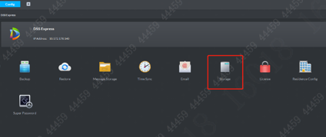
Configuration | Configuring Express
Upgrade
Configuring Picture Storage Space
Adding Devices
Modify the features
Configuring People Info.
Configuring Face Recognition Terminal
Commissioning
Configuring Temperature and Mask Alarm
Configuring Door Unlock Method
Configuring NVR
Configuring Express
2
2
Configuring DMSS
1
Log in DSS Express Client, Click “Config”
Select “Storage”

Slide 31
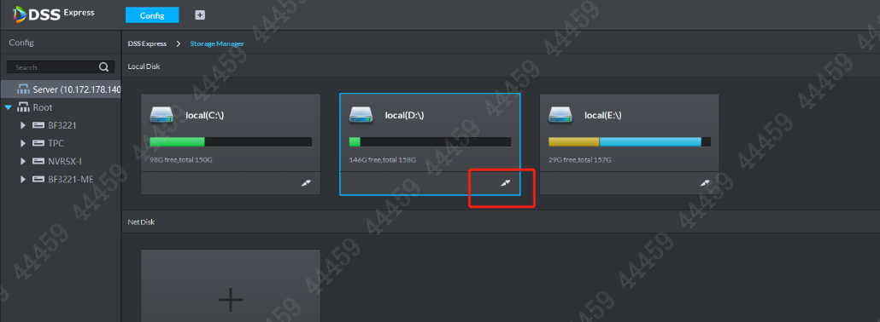

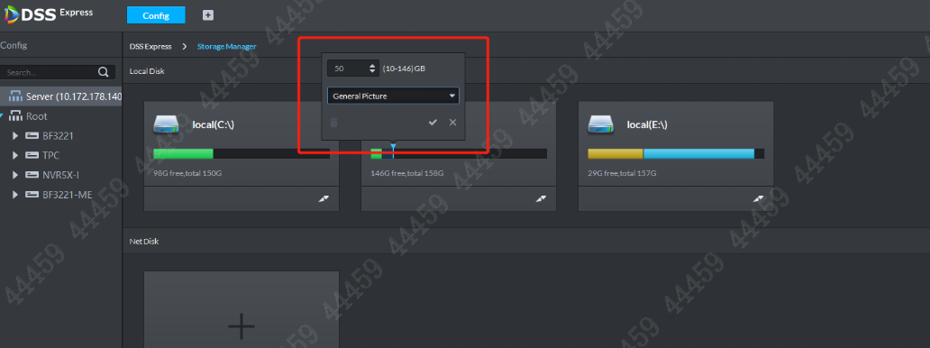
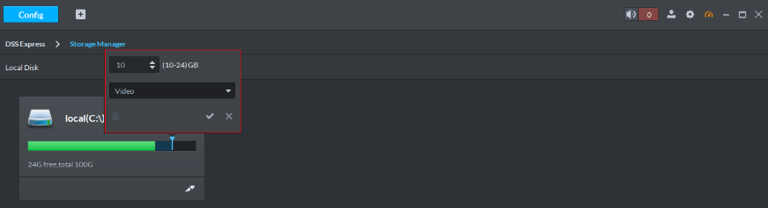
Configuration | Configuring Express
Upgrade
Configuring Picture Storage Space
Adding Devices
Modify the features
Configuring People Info.
Configuring Face Recognition Terminal
Commissioning
Configuring Temperature and Mask Alarm
Configuring Door Unlock Method
Configuring NVR
3. Choose the local Disk you want to storage the pictures, then click
4. Set the storage space, then select “General Picture”, Click ( If there is no NVR, you have to set the “video” & “General Picture” storage on Express. If there is NVR, you only set the “General Picture” storage on Express, then the NVR store the video）
Configuring Express
3
Configuring DMSS
4

Slide 32
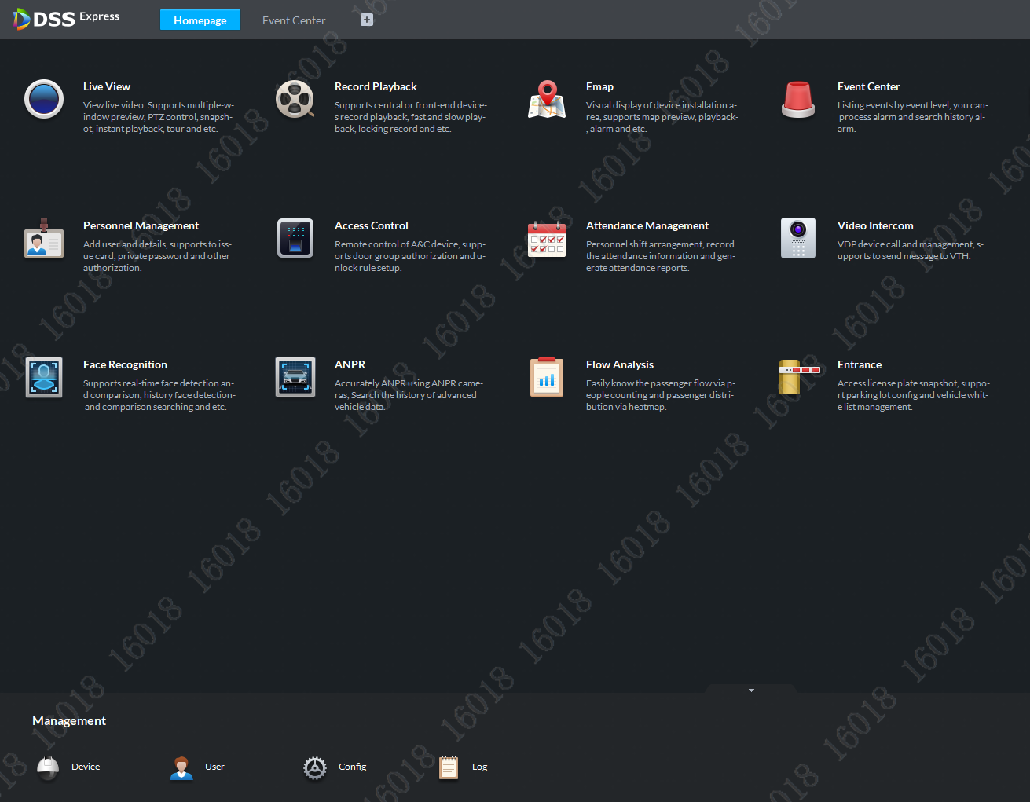
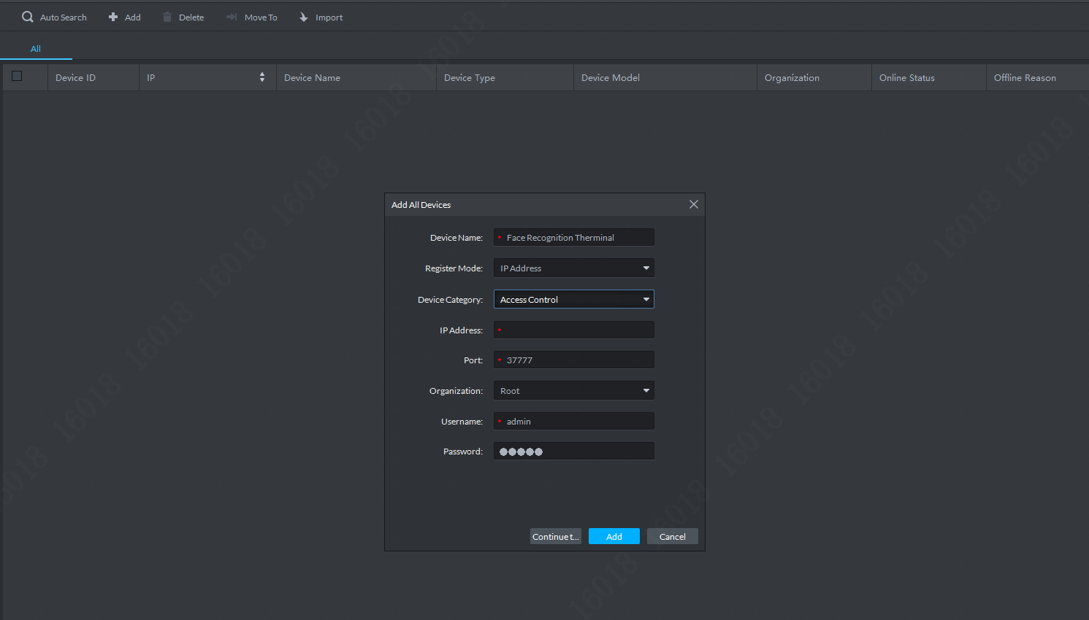
Configuration | Configuring Express
Upgrade
Configuring Picture Storage Space
Adding Devices
Modify the features
Configuring People Info.
Configuring Face Recognition Terminal
Commissioning
Configuring Temperature and Mask Alarm
Configuring Door Unlock Method
Configuring NVR
2
Configuring Express
Configuring DMSS
3
1
Log in DSS Express Client, Click “Device”
Click “Add”
Input the face recognition terminal IP, user name , password, select the device category as “Access Control” , then click “Add”.

Slide 33
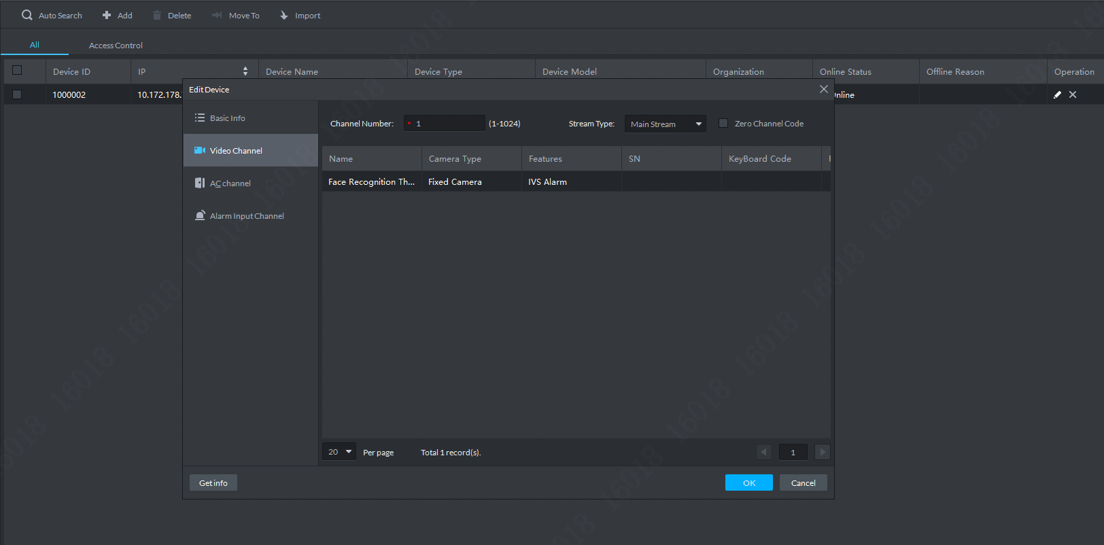
Configuration | Configuring Express
Upgrade
Configuring Picture Storage Space
Adding Devices
Modify the features
Configuring People Info.
Configuring Face Recognition Terminal
Commissioning
Configuring Temperature and Mask Alarm
Configuring Door Unlock Method
Configuring NVR
3
1
2
Configuring Express
Configuring DMSS
4
Select the Face Recognition Terminal you want to edit, click .
Select “Video Channel”
Modify the value in the Channel Number box from 0 to 1，set the features as “IVS Alarm”
Click “OK”

Slide 34

Configuration | Configuring Express
Upgrade
Configuring Picture Storage Space
Adding Devices
Modify the features
Configuring People Info.
Configuring Face Recognition Terminal
Commissioning
Configuring Temperature and Mask Alarm
Configuring Door Unlock Method
1
Configuring NVR
Configuring Express
1
Configuring DMSS
2
Select Personnel Management, click >Template Download, and then save the template locally.
Click OK.

Slide 35

Configuration | Configuring Express
Upgrade
Configuring Picture Storage Space
Adding Devices
Modify the features
Configuring People Info.
Configuring Face Recognition Terminal
Commissioning
Configuring Temperature and Mask Alarm
Configuring Door Unlock Method
Configuring NVR
Configuring Express
Configuring DMSS
Unzip the template, provide the face images, name them, and then fill people info in the template. When filling the template, conforn to the rules as descripted in the file.
Zip the file again.

Slide 36
Configuration | Configuring Express
Upgrade
Configuring Picture Storage Space
Adding Devices
Modify the features
Configuring People Info.
Configuring Face Recognition Terminal
Commissioning
Configuring Temperature and Mask Alarm
Configuring Door Unlock Method
5
Configuring NVR
Configuring Express
5
Configuring DMSS
6
Go back to Express, Select Personnel Management, click > Import File , and then upload the ZIP file.
Click OK.

Slide 37


Configuration | Configuring Express
Upgrade
Configuring Picture Storage Space
Adding Devices
Modify the features
Configuring People Info.
Configuring Face Recognition Terminal
Commissioning
Configuring Temperature and Mask Alarm
Configuring Door Unlock Method
Configuring NVR
Configuring Express
Configuring DMSS
Select Access Control >
Right-click on the door channel of the face recognition terminal, and then click Door Configuration.
Select the unlock method as “and”, you have to choose the face, The Face method is required, and others are optional.
Click Apply.

Slide 38


Configuration | Configuring Express
Upgrade
Configuring Picture Storage Space
Adding Devices
Modify the features
Configuring People Info.
Configuring Face Recognition Terminal
Commissioning
Configuring Temperature and Mask Alarm
Configuring Door Unlock Method
1
Configuring NVR
4
3
Configuring Express
2
Configuring DMSS
On the Homepage of Express, click Config.
Select the Door channel under the face recognition terminal, and then click Event Configuration.
Click A & C Alarm, click High Temperature Abnormal Alarm or Not mask alarm, and then click to enable it, indicates that the alarm is enabled .
Click Link Video, select the face recognition terminal from the device list, and then select the check boxes next to After alarm is triggered, camera snapshot and When alarm is triggered, open camera on client.

Slide 39

Configuration | Configuring Express
Upgrade
Configuring Picture Storage Space
Adding Devices
Modify the features
Configuring People Info.
Configuring Face Recognition Terminal
Commissioning
Configuring Temperature and Mask Alarm
Configuring Door Unlock Method
Configuring NVR
Configuring Express
Configuring DMSS
Live Monitoring
Viewing Records
Log in to the Express Client
Select Body Temp Monitoring. Click to choose the device, then the results are displayed in real time.

Slide 40


Configuration | Configuring Express
Upgrade
Configuring Picture Storage Space
Adding Devices
Modify the features
Configuring People Info.
Configuring Face Recognition Terminal
Commissioning
Configuring Temperature and Mask Alarm
Configuring Door Unlock Method
Configuring NVR
Configuring Express
Configuring DMSS
Live Monitoring
Viewing Records
Log in DSS Express Client, select Access Control.
Click to check the real-time records or to search for history records.
Check whether the access control records show face recognition results, temperature measurement results and mask-wearing info.

Slide 41

Configuration | Configuring DMSS
Upgrade
Installation
Adding Device to DMSS
Subscribing Alarms
Commissioning
Configuring Face Recognition Terminal
Configuring NVR
Configuring Express
Configuring DMSS
Please scan the QR code to download DMSS APP .

Slide 42


Configuration | Configuring DMSS
Upgrade
Installation
Adding Device to DMSS
Subscribing Alarms
Commissioning
Configuring Face Recognition Terminal
Configuring NVR
You can add device by scanning device QR code or manually entering device SN.
On the Home interface, tap ,and then select SN/Scan.
Scan device QR code, or manually enter device SN, and then the system will identify the device type automatically. If the device type cannot be automatically identified by the system, you need to select the device type.
Enter device name, device password, and save settings.
Configuring Express
Configuring DMSS

Slide 43


Configuration | Configuring DMSS
Upgrade
Installation
Adding Device to DMSS
Subscribing Alarms
Commissioning
Configuring Face Recognition Terminal
Configuring NVR
Log in to DMSS.
Tap
Tap , and then find and tap the face recognition terminal you are going to subscribe alarm message for.
Tap next to Notification to enable automatic push of access control alarms. indicates that the notification is enabled.
Configuring Express
Configuring DMSS

Slide 44



Configuration | Configuring DMSS
Upgrade
Installation
Adding Device to DMSS
Subscribing Alarms
Commissioning
Configuring Face Recognition Terminal
Configuring NVR
Configuring Express
Trigger a human body temperature alarm (temperature higher than the threshold).
Log in to DMSS.
Tap , find and tap the name of the face recognition terminal, and then check whether the body temperature alarm is displayed.
Configuring DMSS

Slide 45
01
Overview
02
Installation Guidance
Topology, Scenarios, Device List, Function List
Face Recognition Terminal
03
Configuration
04
FAQ
Upgrade, Face Recognition Terminal, NVR, Express, DMSS
Solution FAQ

Slide 46

FAQ | Solution FAQ
The maximum number of face recognition access controllers that can be connected to NVR (DHI-NVR5216-16P-I).
16 face recognition access controllers for now
2. A green square appears on the image after modifying Bitrate on the Web interface of face recognition access controller.
It disappears after you restart the controller, and the Bitrate value remains as you have set before restarting the device.
3. In the face + card mode, how many pieces of access control logs are generated on Express for one door control action.
There are 4 access control logs on Express for one door control action—Unlock Verification: Card swiping, Normal Unlock: Face recognition, Card and Face Unlock: Card swiping + face recognition, Normal Unlock: Closing door.

Slide 47

FAQ | Solution FAQ
4. In the face + card mode, how many pieces of access control logs are generated on the controller for one door control action.
There are 2 access control logs on the face recognition access controller for one door control action. They are both Card + Face. The first one indicates Card Swiping and the second one indicates Face Recognition.
The reason why it often fails to send face database from Express to the face recognition access controller.
Conform to the requirements on face image: Size not more than 75 KB, and face coverage from 30% to 70%.
On DMSS, the alarm push shows no captured and registered images.
The alarm push only contains the temperature info and face snapshot.
Temperature monitoring fails after Anti-fake is enabled on the face recognition access controller.
Do not enable Anti-fake during temperature monitoring.
How to see temperature overlay over live view on DMSS?
Temperature overlay on live view is only supported on main stream.

Slide 48


You can download the manuals from Dahua Support Website.
https://www.dahuasecurity.com/user/login?redirect_url=011101
Use Dahua user name and password to log in the solution center
Support > Solutions Center > SMB Solution > Temperature Monitoring Solution > Access Control Temp. Monitoring

