Slide 1
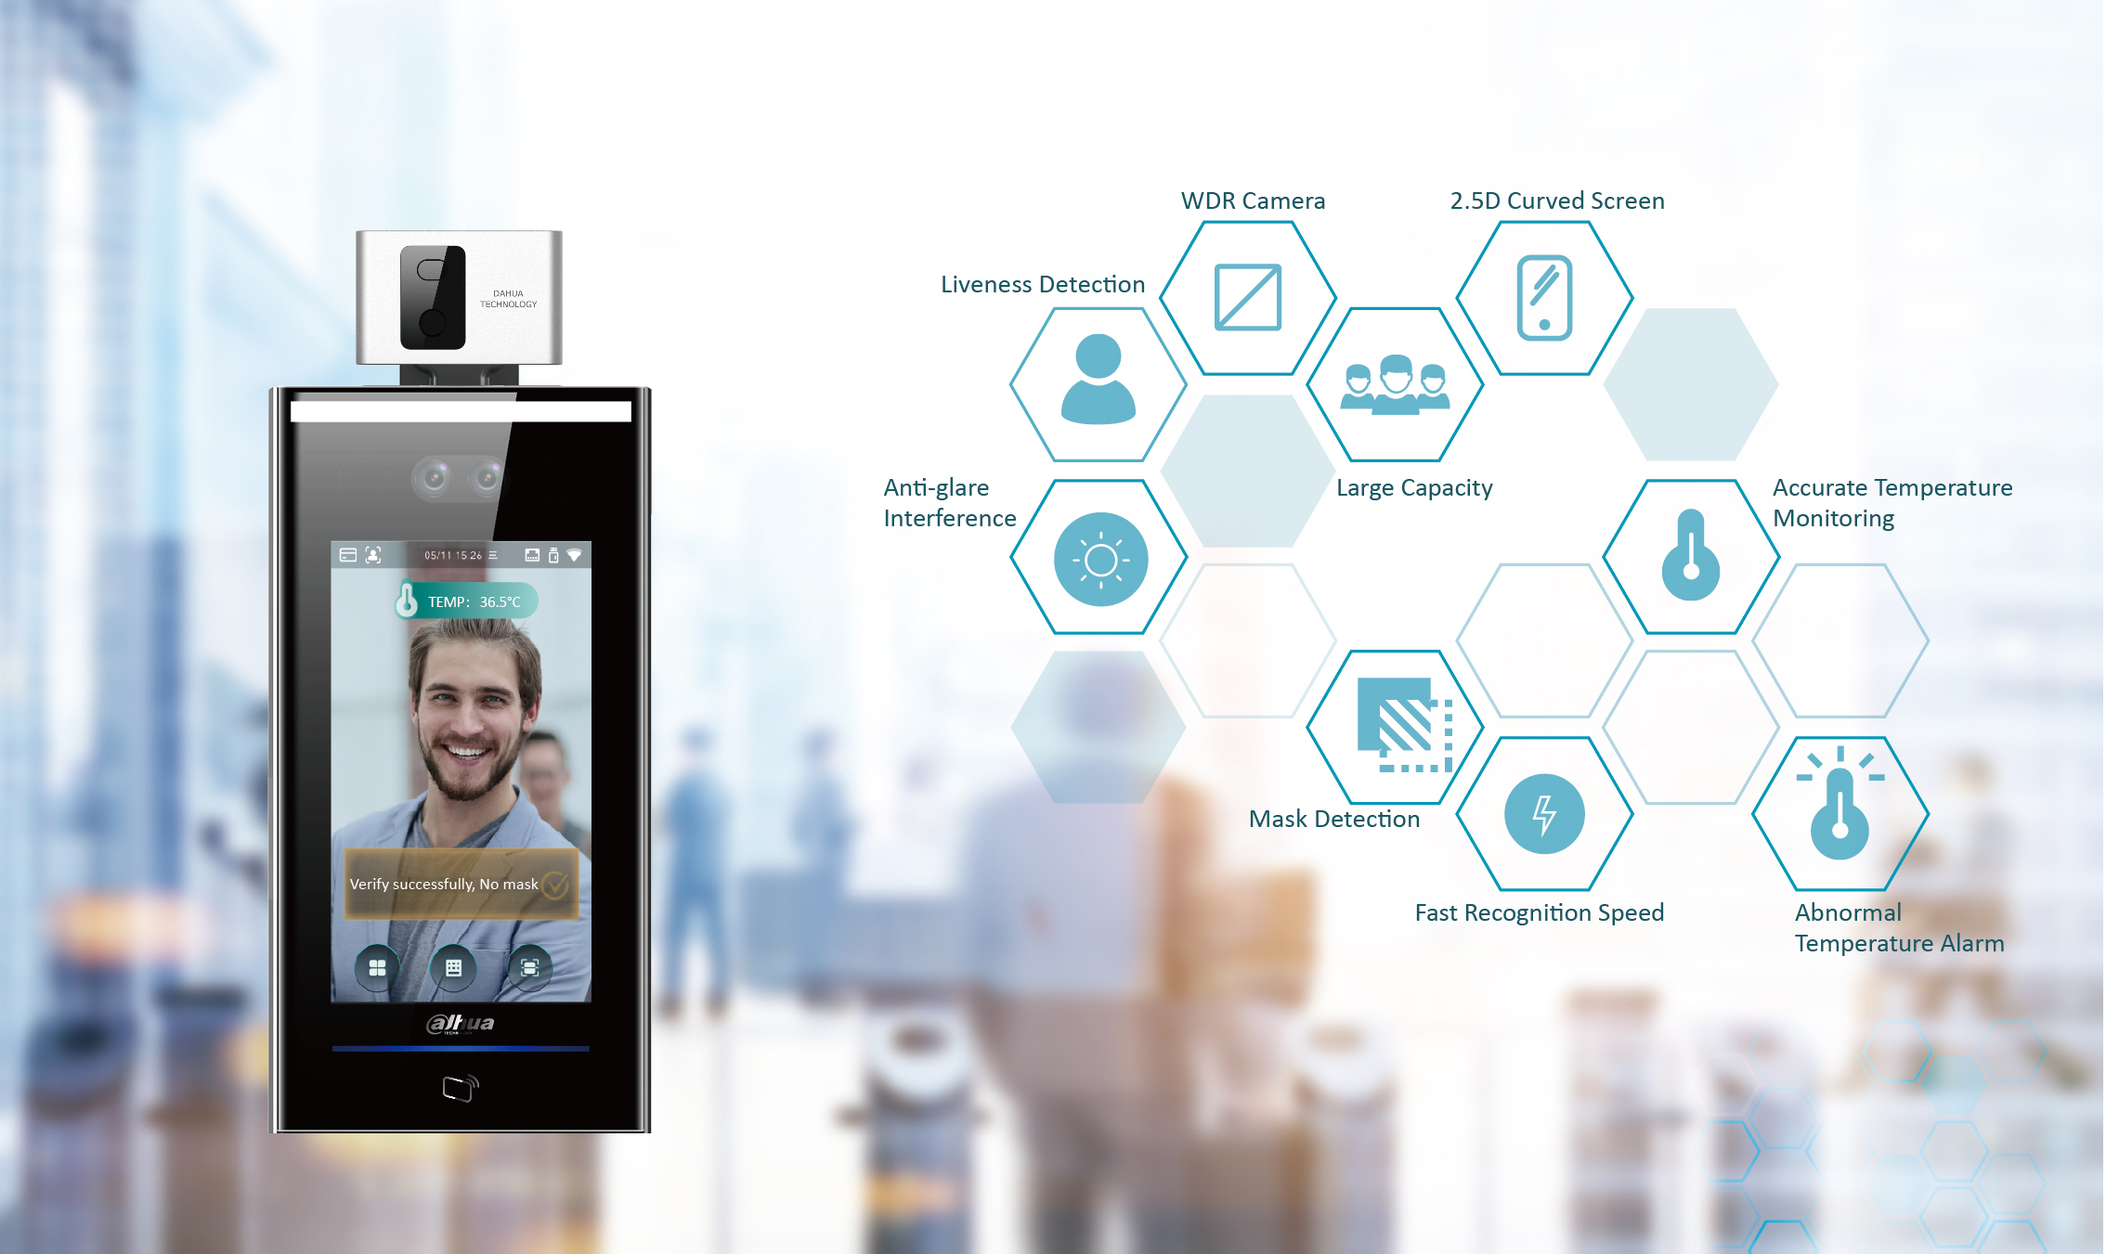

DHI SMB Access Control Temperature Monitoring Solution
--Simple Deployment, Safe Passage

Slide 2

1
Background & Challenge
2
Solution Overview
3
Solution Values
4
Product List
5
Successful Cases

Slide 3
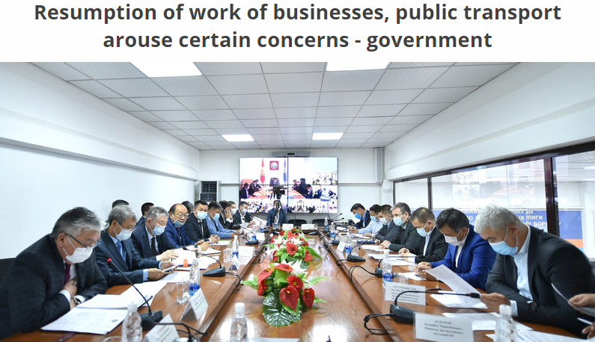
Background
With the gradual resumption of businesses, work and school classes, we need a simple and economical solution to ensure people's safety.
Dahua launched Access Control Temperature Monitoring Solution, it integrates face recognition and temperature monitoring technology into a access control management system, enabling a safe working and learning environment.

Slide 4



Challenges
Current Status
Requirements
The world is still fighting against the epidemic
Needs high temperature monitoring accuracy
Needs non-mask detection
Needs easier deployment and operation
Needs a simple and economical solution
Gradual resumption of work and classes

Slide 5
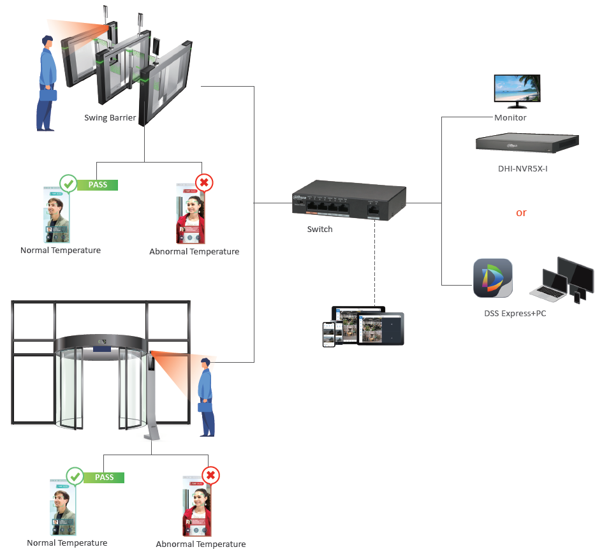
Solution Overview | Process
This solution integrates face recognition and temperature monitoring technology into a well coordinated access control management system, enabling a safe working and learning environment.

Slide 6
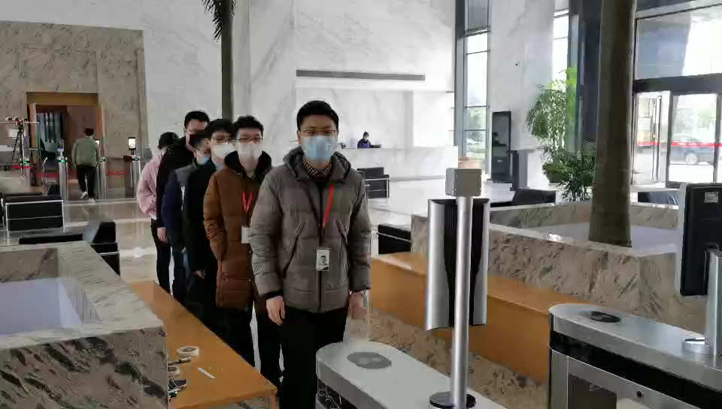
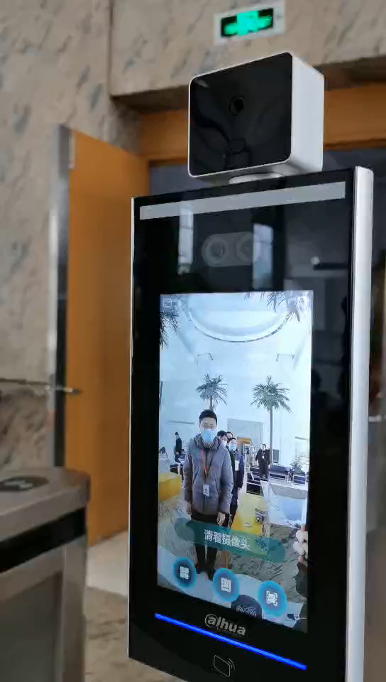
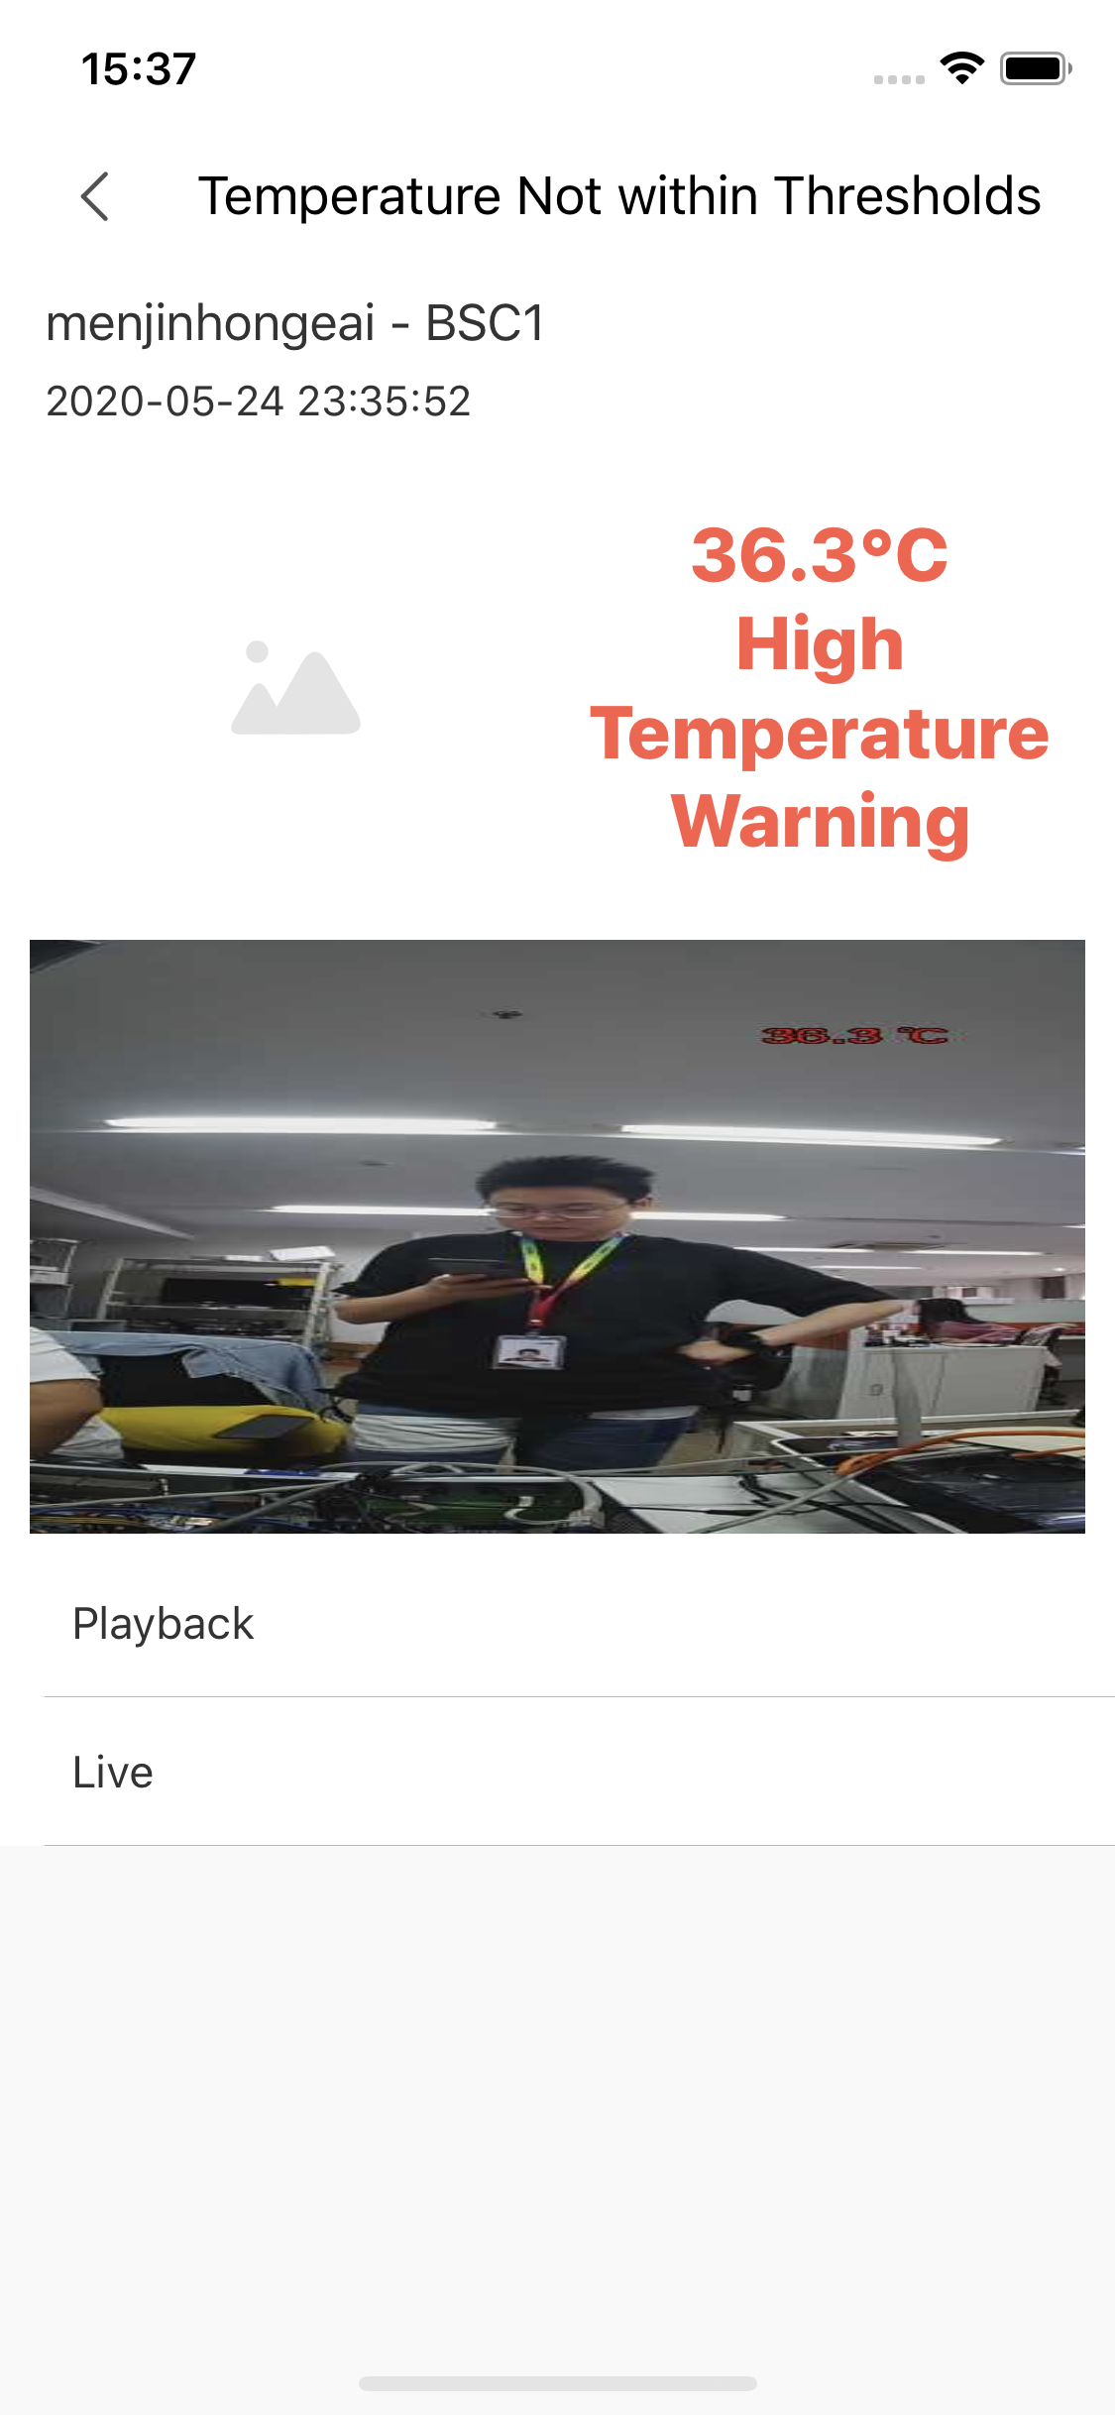
Solution Values
Supports temperature monitoring, abnormal temperature reminds with sounds, no additional staff
Temperature monitoring accuracy: ± 0.5°C （Indoor space)
Supports face recognition and non-mask detection
Non-contact access to reduce cross-infection
Fast access to prevent congestion
Easy to work with third party barrier or locks
DMSS supports real-time display and alarm push notification for abnormal temperature

Slide 7
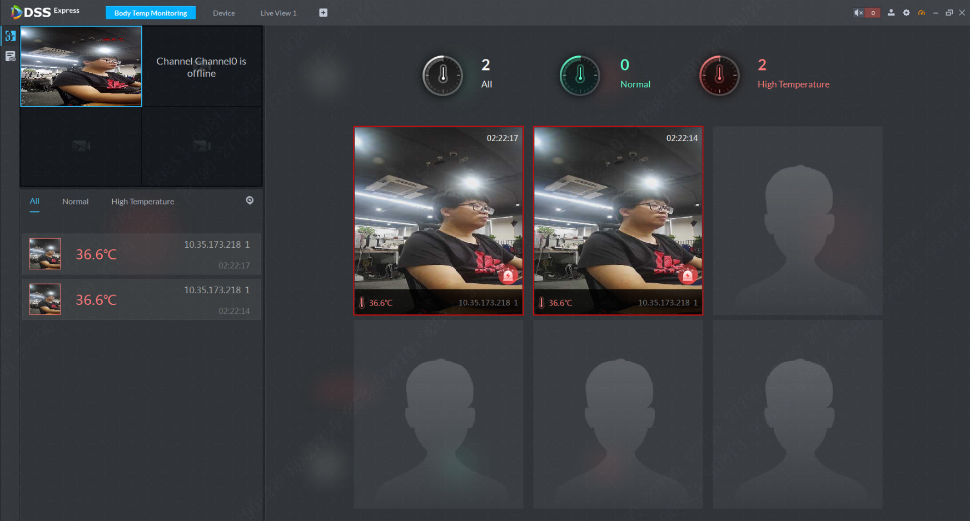
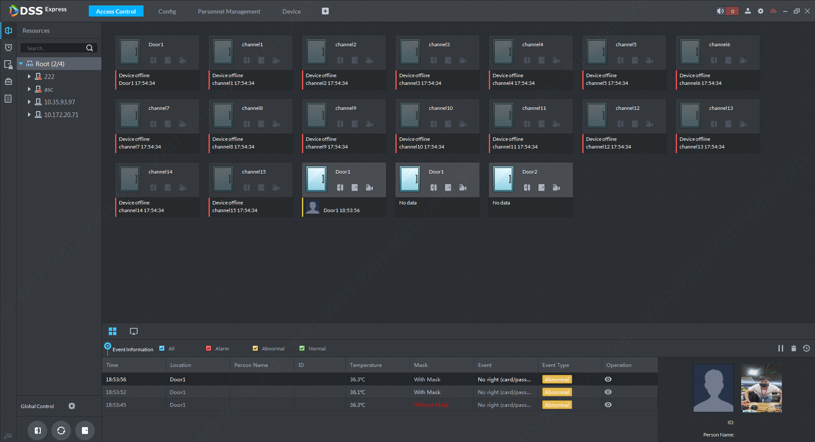
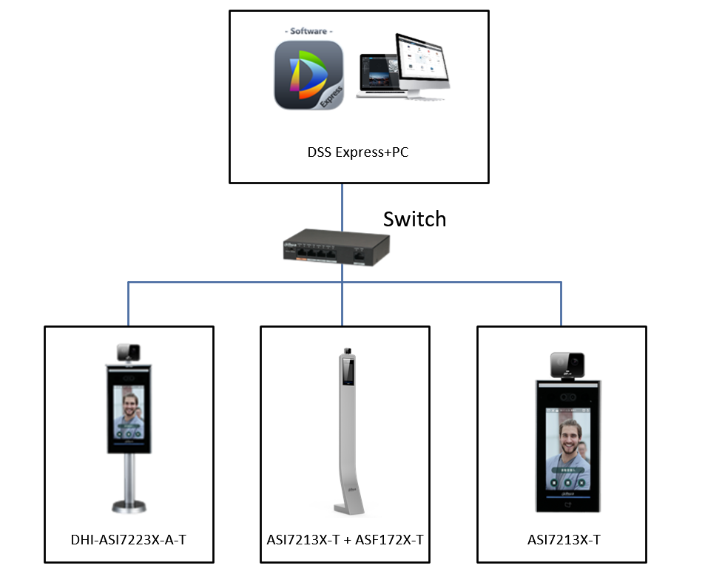
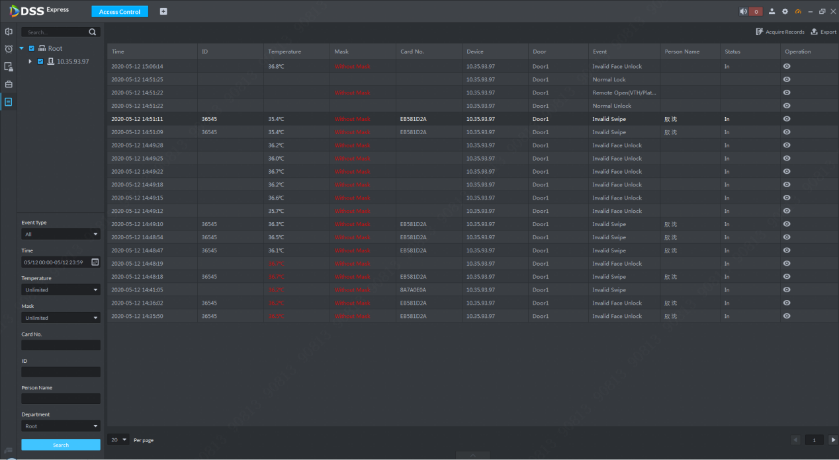
Solution Values
Supports real-time display
Supports alarm pop-up for abnormal human temperature detected
Supports data statistics and report export
Supports data history backtracking
Supports face images batch-import
Rich alarm linkage for events
Fast delivery
Real-time display and alarm pop up
Rich alarm linkage for events
Data statistics and report export

Slide 8
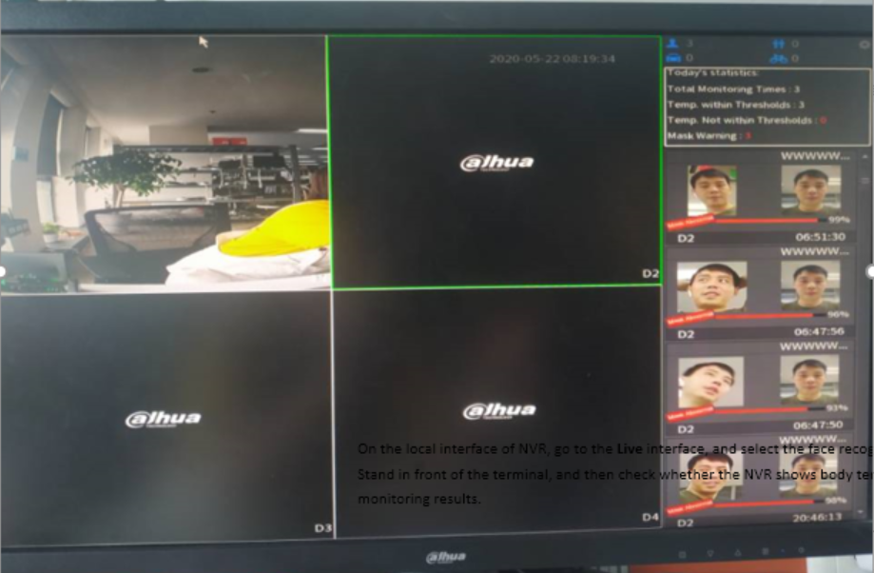
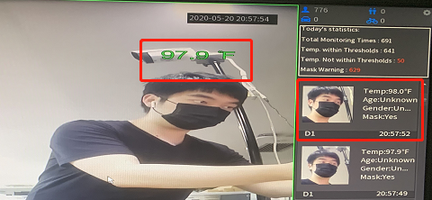
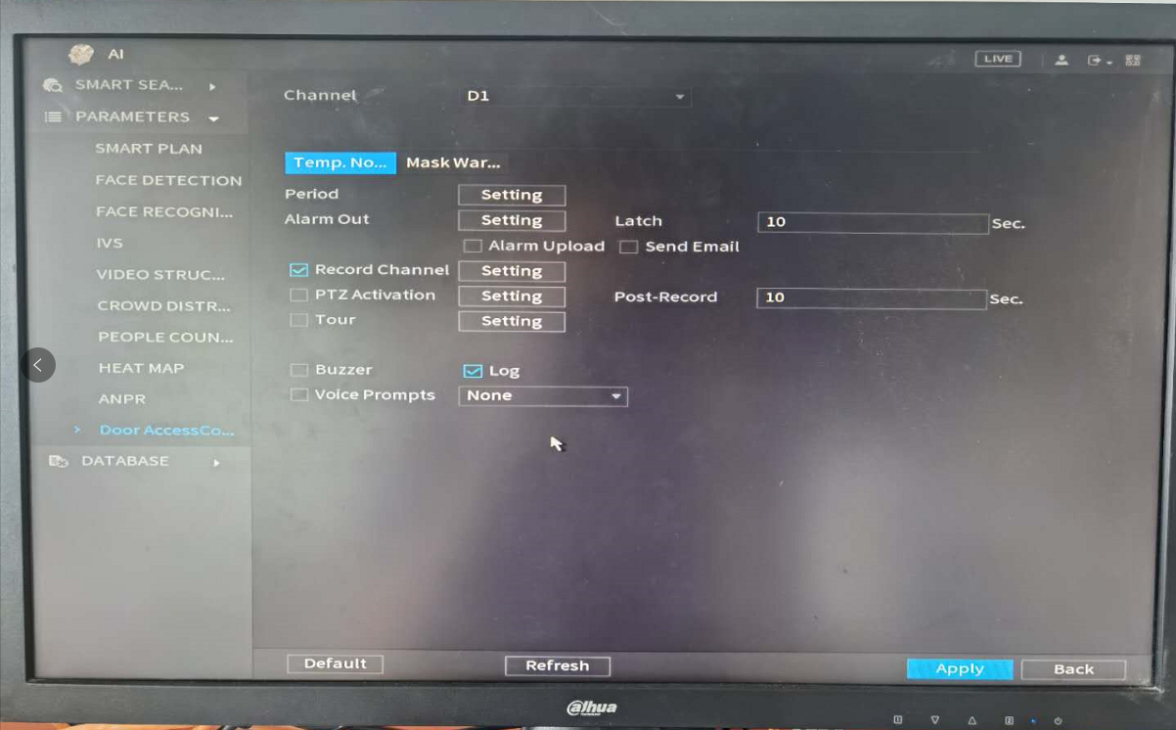
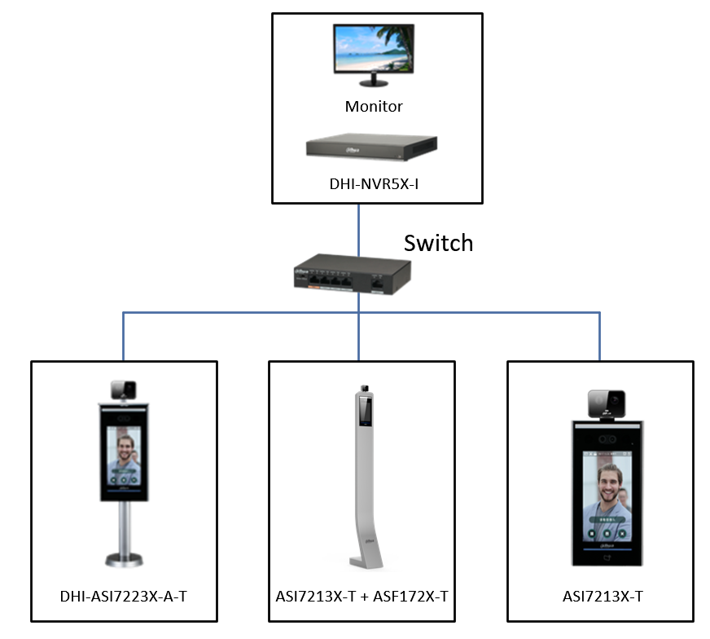
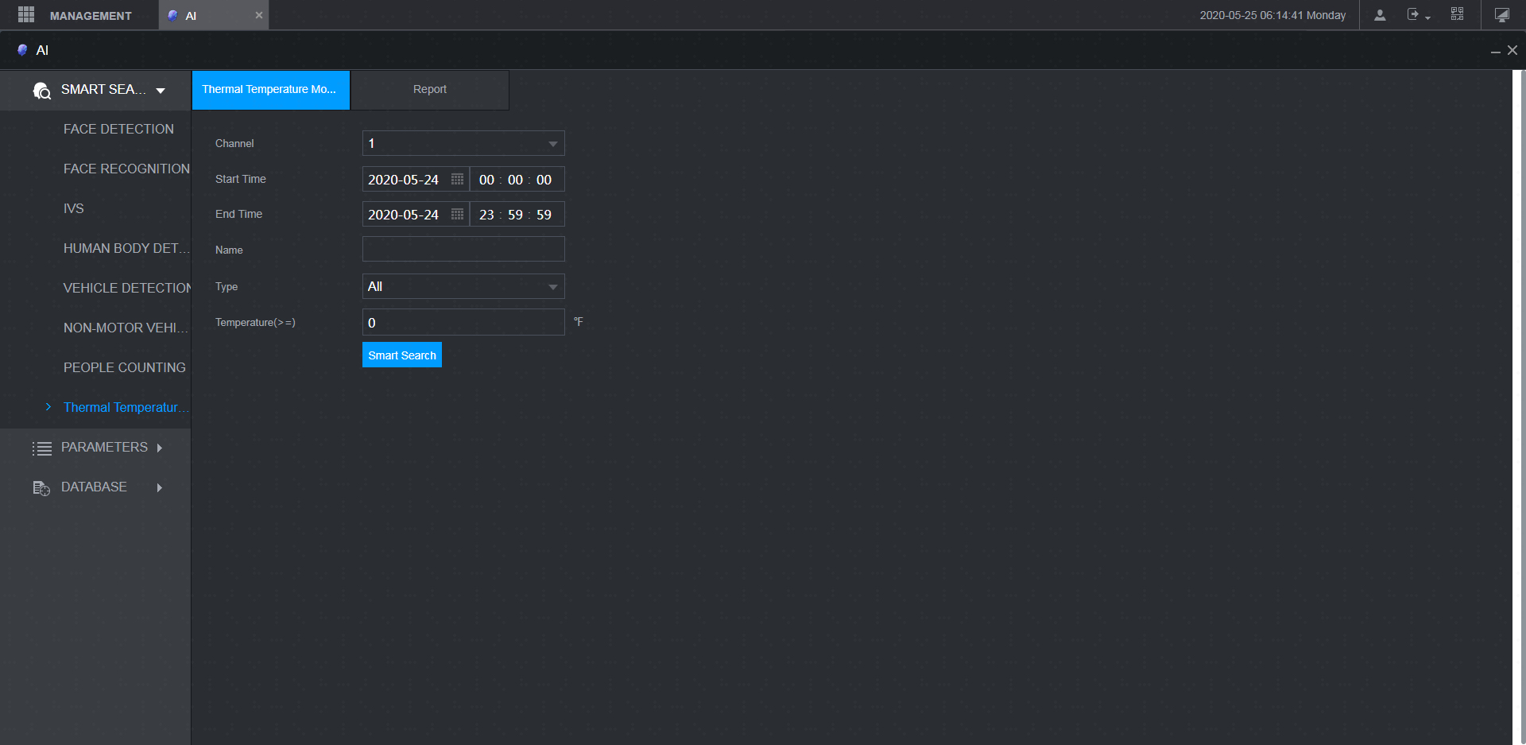
Solution Values
Supports real-time display
Supports alarm pop up for abnormal human temperature detected
Supports data statistics and report export
Supports data history backtracking
Rich alarm linkage for events
Supports video storage
Real-time display and alarm pop up
Rich alarm linkage for events
Data statistics and report export

Slide 9
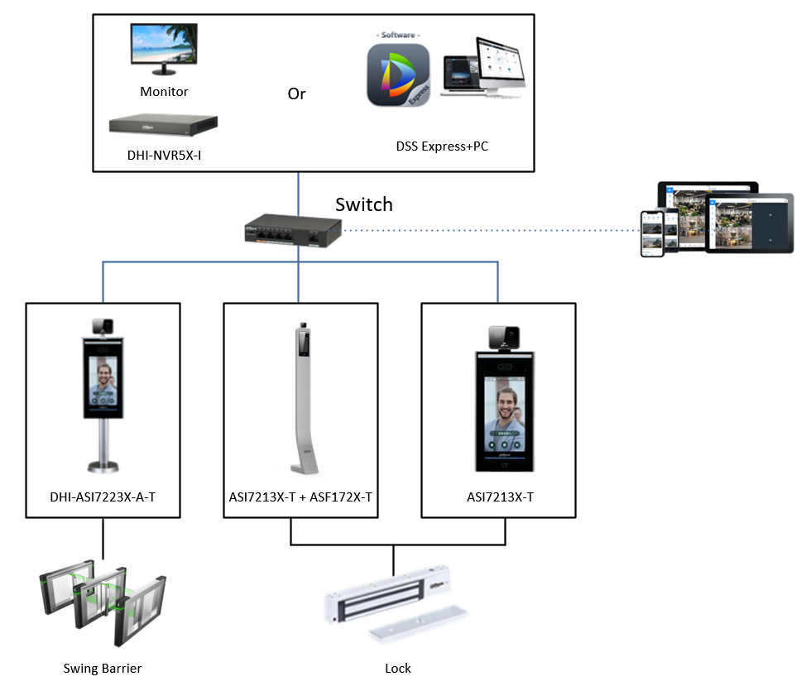
How to choose solution?
 | DSS Express | NVR5X-I
Alarm pop-up for abnormal human temperature detected | √ | √
Real-time display | √ | √
Data statistics and report export | √ | √
Data history backtracking | √ | √
Video storage |  | √
Supports face batch-import | √
Rich alarm linkage | √ | √
Visual effects | Display more intuitively
Access control records | √

Slide 10

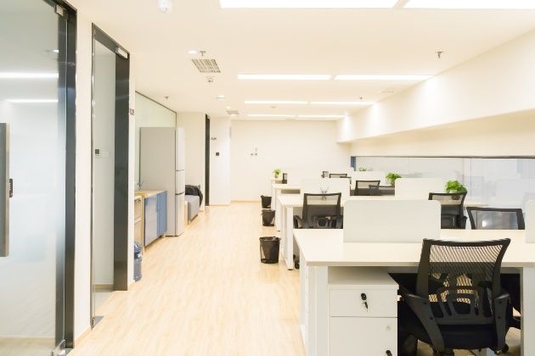
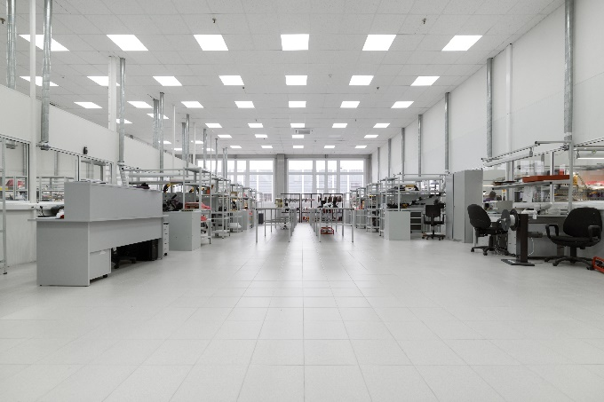
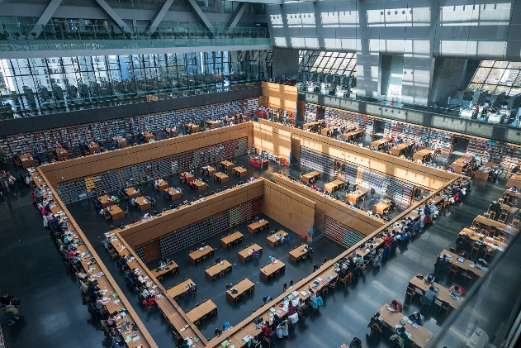
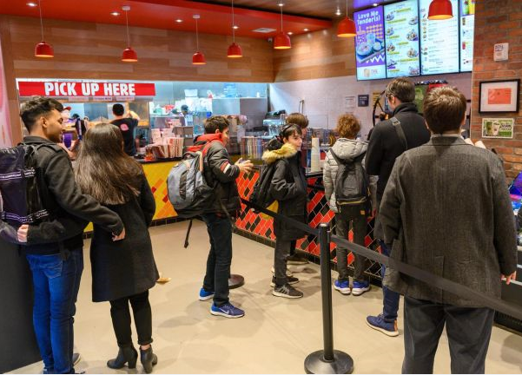
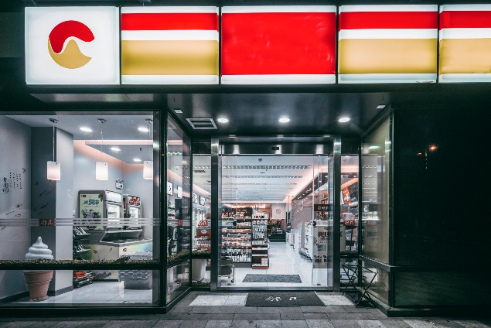
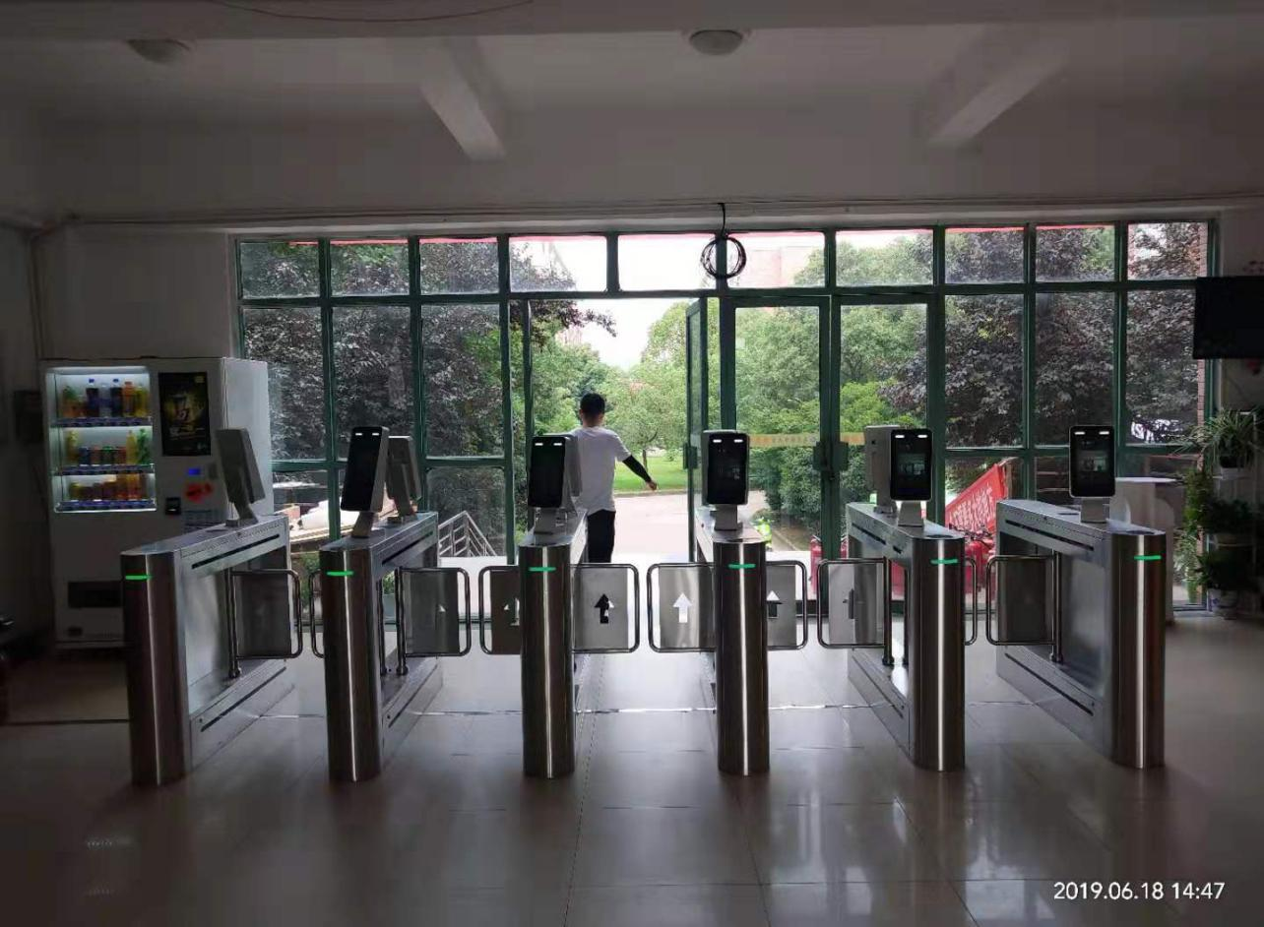
Application Scenarios
Office Entrance
Factory Entrance
Library Entrance
Chain Restaurant Entrance
Store Entrance
School Entrance

Slide 11
Product List
No. | Products | Models | Picture | Parameter | Remarks
1 | Standalone | DHI-ASI7213X-T1 |  | 7-inch touch screen Ambient temperature range: 16°C ~ 32°C Temperature accuracy: ≤0.5℃ Temperature monitoring distance: 0.3m ~ 1.8m Sound prompt: Temperature abnormal alarm Unlock Mode: Face/Card/Password | Wall mounted
 |  | DHI-ASI7213X-T1+ASF172X-T1 |  | 7-inch touch screen Ambient temperature range: 16°C ~ 32°C Temperature accuracy: ≤0.5℃ Temperature monitoring distance: 0.3m ~ 1.8m Sound prompt: Temperature abnormal alarm Unlock Mode: Face/Card/Password | Vertical mounted
2
 |  | DHI-ASI7223X-A-T1 |  | 7-inch touch screen Ambient temperature range: 16°C ~ 32°C Temperature accuracy: ≤0.5℃ Temperature monitoring distance: 0.3m ~ 1.8m Sound prompt: Temperature abnormal alarm Unlock Mode: Face/Password
3

Slide 12

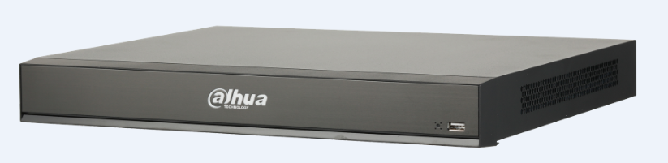
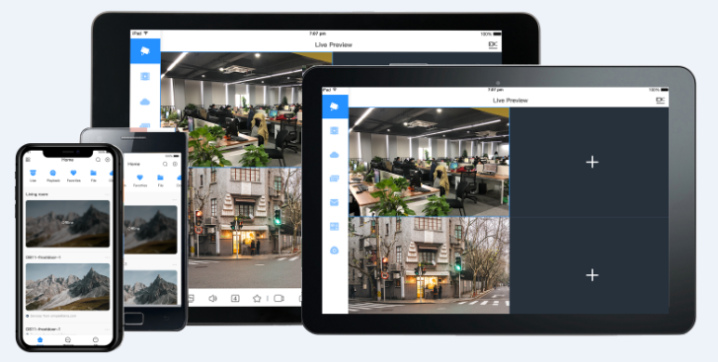
Product List
No. | Products | Models | Picture | Parameter | Remarks
4 | Software | DHI-DSSExpress-Base-License |  | Supports real-time display Supports data statistics and report export Supports alarm pop up Rich alarm linkage for events Fast delivery
5 | NVR | DHI-NVR5216-16P-I |  | Supports real-time display Supports data statistics and report export Supports alarm pop up Rich alarm linkage for events Supports video storage | Optional
6 | DMSS | DMSS |  | Supports real-time display Supports alarm push

Slide 13
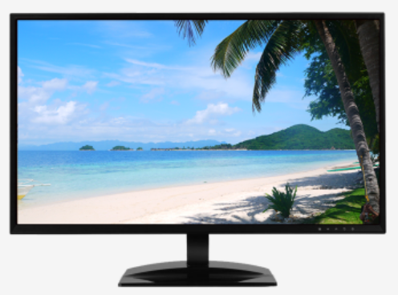
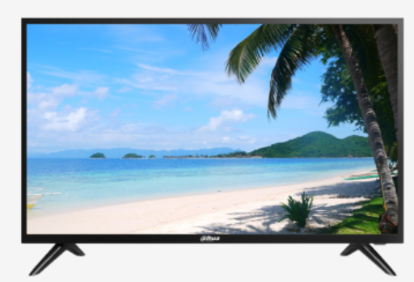
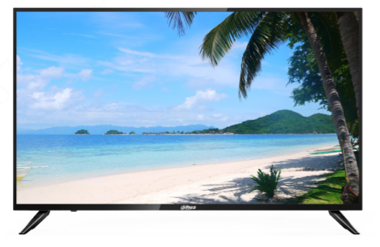
Product List
No. | Products | Models | Picture | Parameter | Remarks
7 | Monitor (optional) | DHI-DHL22-F600-S |  | Industrial level LCD panel, suitable for continuous 24/7 operation Physical resolution of 1920×1080 High fidelity digital processing for a brilliant and vivid video Built-in speakers Good compatibility with DVRs and NVRs
8 |  | DHI-LM32-F200 |  | Light and cost-effective plastic housing 178°H/178°V extra-wide viewing angle for overall viewing performance High fidelity digital processing for a brilliant and vivid video Support multiple signal inputs such as HDMI, VGA and USB Built-in speakers
9 |  | DHI-LM43-F200 |  | Light and cost-effective plastic housing 178°H/178°V extra-wide viewing angle for overall viewing performance High fidelity digital processing for a brilliant and vivid video Support multiple signal inputs such as HDMI, VGA and USB Built-in speakers

Slide 14
Successful Cases

Slide 15
Simple, Manageable, Brilliant
Simplify Your Business, Grow Together

